Slide 1
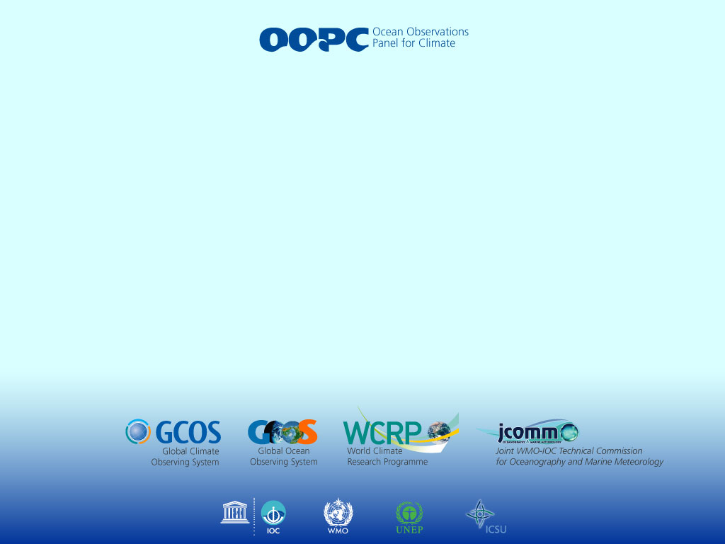
Select US and International Programs Flux-Related Programs
Mark Bourassa
COAPS, EOAS and GFDI, Florida State University
Co-chair of the Ocean Observation Panel for Climate
With input from
Albert Fischer, Katy Hill

Slide 2
Outline
Recognized Relevance of Fluxes by National and International Programs
Upcoming Activities that are critically dependent on fluxes
  Earth Systems Modeling
  Grand Challenges
International groups that focus on observational requirements for climate
  Many groups (3 or 4 letter acronyms) want to establish requirements
  As of yet, there are few requirements on surface fluxes
  Most flux-related bulk variables are considered, but not for fluxes
A new Implementation Plan for the Global Climate Observing System
  To be drafted late 2016
  We are considering adding surface fluxes and Essential Climate Variables

Slide 3
Recognized Relevance of Fluxes
National Programs
  NASA NEWS – NASA Energy and Water Cycle
    Contributions to the Energy and Water Cycle
  NOAA Climate Observing Division (COD)
  National Ocean Forecasting Agencies
International Programs
  TIE-OHC
  Seaflux
  WCRP – World Climate Research Program
    GEWEX – Global Energy and Water EXchanges
    CLIVAR
  Research Coordination Network (RCN)
  Global Ocean Observing System (GOOS)
  Global Climate Observing System (GCOS)

Slide 4
US National Programs – Potential for collaboration
NASA NEWS – NASA Energy and Water Cycle
  Contributions to the Energy and Water Cycle
  A new team was put together in late 2014 and early 2015
    A plausible group for collaboration
NOAA Climate Observing Division (COD)
  Researchers identified surface fluxes as the leading cause of error
National Ocean Forecasting Agencies
  For example, the US Naval Research Laboratory
  Some of these have strong programs on satellite remote sensing and on surface fluxes

Slide 5
High Level International Programs
WCRP – World Climate Research Program
  Trying to understand the water and energy cycle
  Climate Variability in the Oceans
  WCRP, ECMWF, and NCAR are all moving forward or planning to move forward with Earth Systems Modeling
    Surface fluxes will become of greater importance for validation of processes
Research Coordination Network (RCN)
  Supported by US National Science Foundation, IGARSS, others?
  Crosses disciplines and geographical boundaries
Global Ocean Observing System (GOOS)
  Folks that Brought us the Framework for Ocean Observations
  Brings together physical, biogeochemical, and biological programs
Global Climate Observing System (GCOS)
  Sets requirements for climate quality observations
  Considering elevating the importance of surface fluxes

Slide 6

GOOS’s Framework for Ocean Observations (the FOO)
An outcome of OceanObs’09
Codifies best practices
Based on feedbacks between
  Observations
  Research
  Applications
GOOS, RCN, and other (e.g., IOOS and SOOS) all categorize their key variables as
Essential Ocean Variables (EOVs)
GCOS focuses on Essential Climate Variables (ECVs)

Slide 7
Global Climate Observing System (GCOS)
GCOS is divided into three panels
  Atmospheric Observation Panel for Climate (AOPC)
  Terrestrial Observation Panel for Climate (TOPC)
  Ocean Observation Panel for Climate (OOPC)
GCOS was designed to parallel the IPCC, and provide observations to the IPCC
  GCOS is recognized by many high level organizations as the group that:
    Lists key climate variables that should be measured
    Sets climate-related standards for those observations
  ECVs must be
    Important for climate processes
    Feasible to measure (including cost)
    Sufficiently accurate

Slide 8
Sets of EOVs and ECVs Are Not Consistent
IOOS Physical Variables:
  salinity, temperature, bathymetry, sea level, surface waves, surface (vector) currents, ice concentration, surface heat flux, bottom characteristics
  IOOS Meteorological variables are covered by GCOS
GOOS Physical Variables:
  Based on GCOS Ocean variables
Related GCOS Physical Variables:
  Surface: Sea-surface temperature, Sea-surface salinity, Sea level, Sea state, Sea ice, Surface current, Ocean colour, Carbon dioxide partial pressure, Ocean acidity, Phytoplankton.
  Subsurface: Temperature, Salinity, Current, Nutrients, Carbon dioxide partial pressure, Ocean acidity, Oxygen, Tracers
  Atmospheric: temperature, humidity, pressure, Rainfall, Photosyntheticly Active Radiation (PAR), and many others

Slide 9

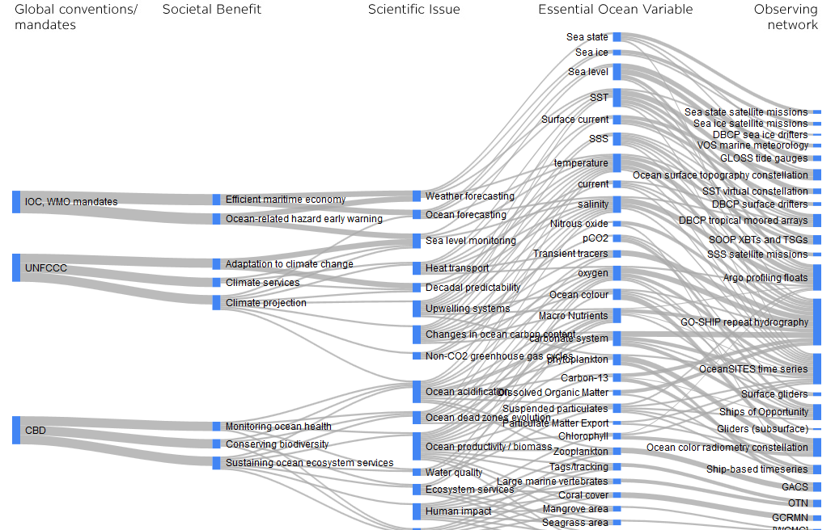
GOOS Strategic Mapping
http://lists-ioc-goos.org/goos-strategic-mapping-graphic

Slide 10
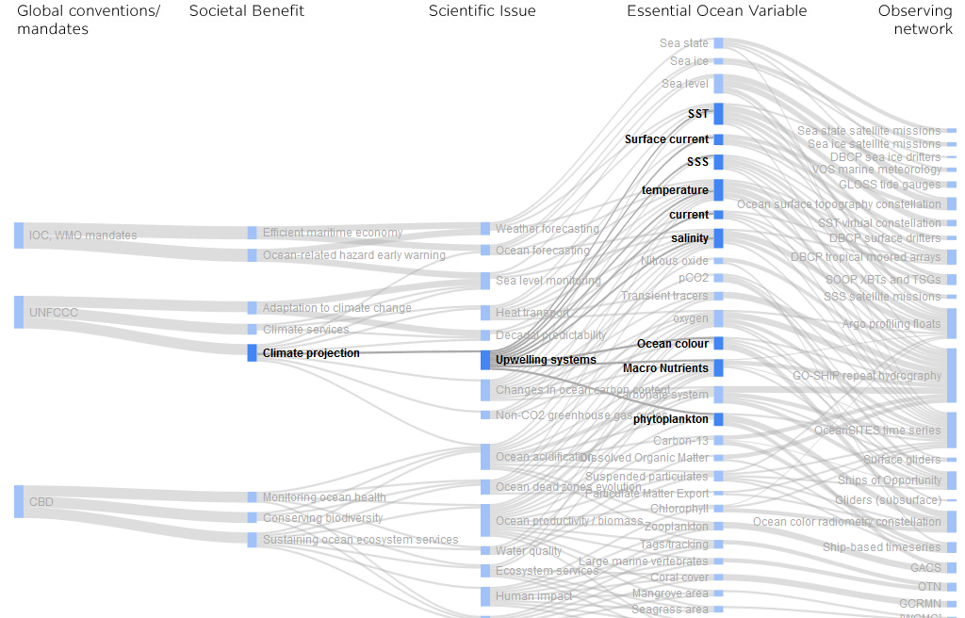
Links from Applications to EOVs

Slide 11
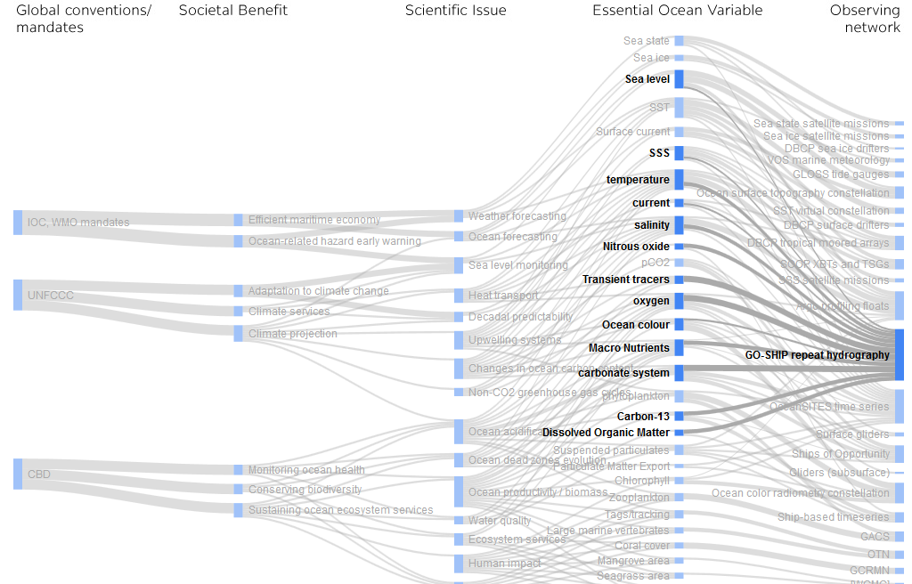
Observation Network Link to ECV

Slide 12
What I Need to Make the Case for Surface Fluxes
Science issues
Societal benefits
Accuracy requirements
  Bias
  Random error (on a specific space and time scale, not per observation)
  Sampling constraints
A plan to achieve the above
  If it is not feasible no sane agency will pay for it

Slide 13
Flux (and Wind Accuracies)
Desired for Various Applications
100 years
50 Wm⁻² (1 ms⁻¹)
10 Wm⁻² (1 ms⁻¹)
5 Wm⁻² (0.5 ms⁻¹)
Climate Change
10 years
1 Wm⁻² (0.1 ms⁻¹)
0.1 Wm⁻² (0.01 ms⁻¹)
Ice Sheet Evolution
ENSO
Annual Ice Mass Budget
1 year
0.01 Nm⁻² (2 ms⁻¹)
Annual Ocean Heat Flux
Coastal Upwelling
Open Ocean Upwelling
Upper Ocean Heat Content & NH Hurricane Activity
1 month
Dense Water Formation
Stress for CO₂ Fluxes
Mesoscale and
shorter scale
physical-biological
Interaction
Ocean Eddies and Fronts
Atm. Rossby Wave Breaking
1 week
Polynyas
Ice Breakup
Shelf Processes
1 day
Inertial Forcing
Conv. Clouds &
Precip
NWP High Impact
Weather
1 hour
10m 100m 1km 10km 100km 10³km 10⁴km 10⁵km

Slide 14
Surface Temperature Processes
Climate variability
Interannual variability
ENSO
Mesoscale & sub-mesoscale variability
Seasonal cycle
Diurnal Variability

Slide 15
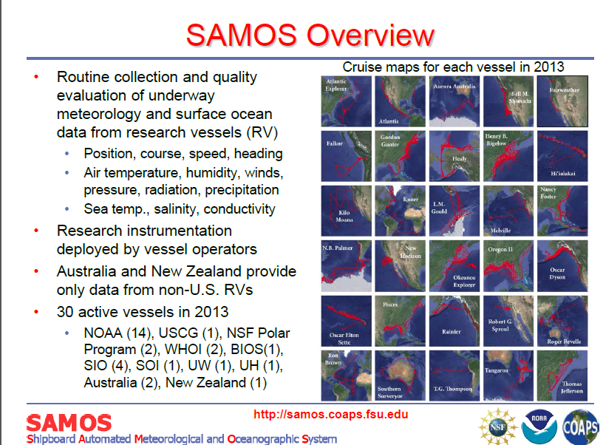

Slide 16
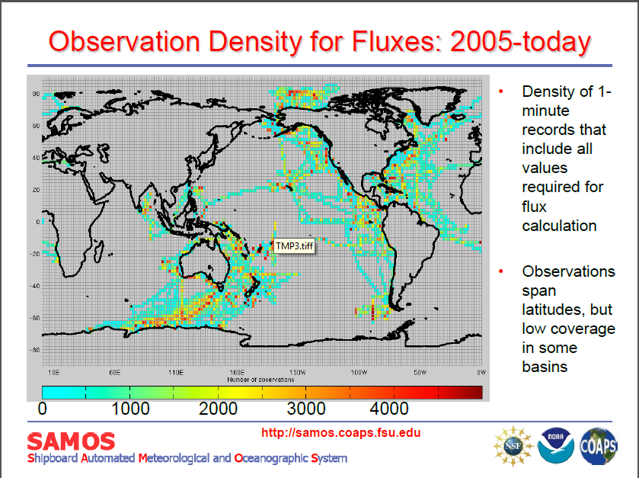

Slide 17
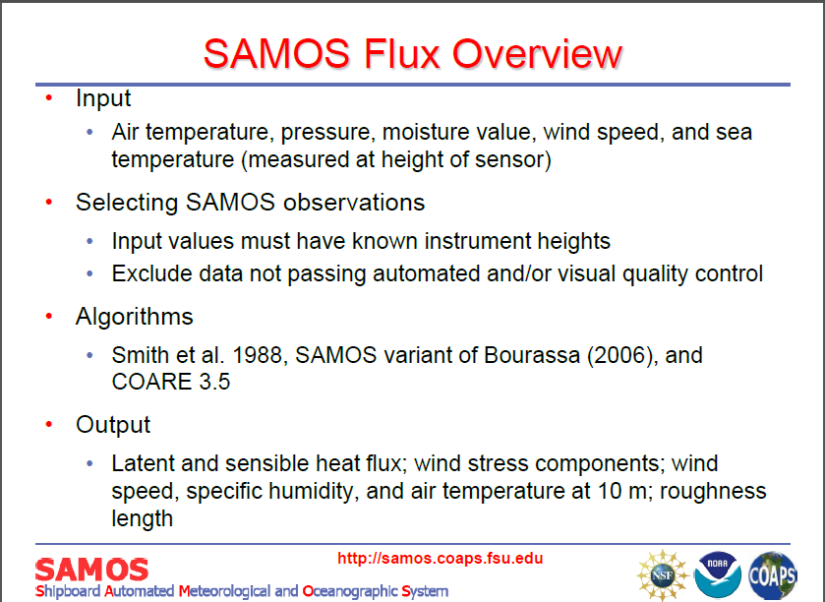

Slide 18
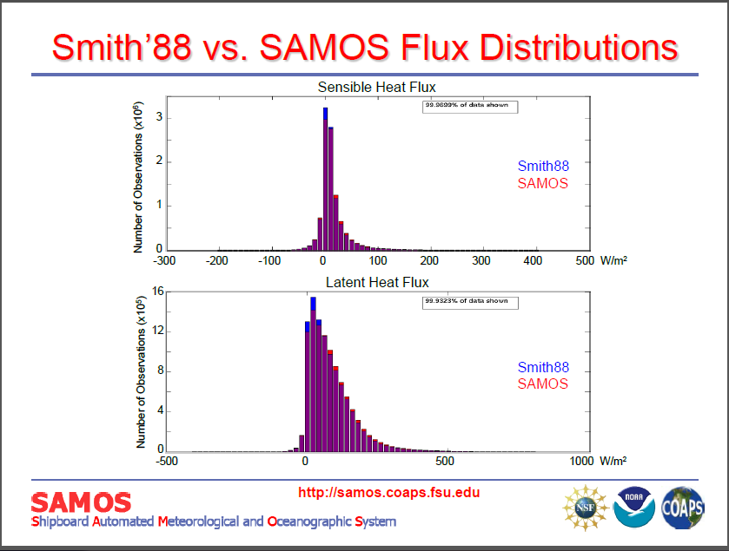

Slide 19
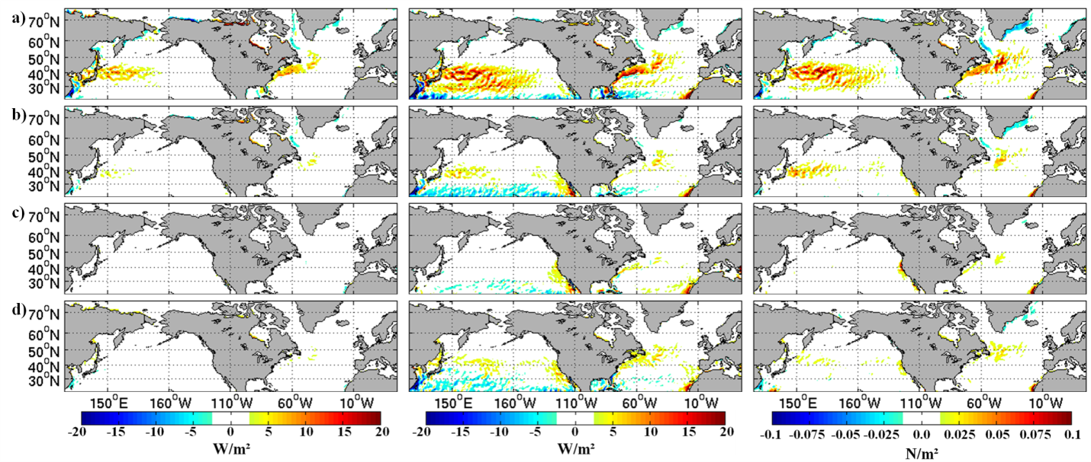
Seasonal Results
Sensible Heat Flux Latent Heat Flux Stress
Fall Summer Spring Winter
2002 – 2003 seasonal average differences in SHF (left), LHF (middle), and wind stress (right) for DJF (top row), MAM (2nd row), JJA (3rd row), and SON (bottom row)

Slide 20
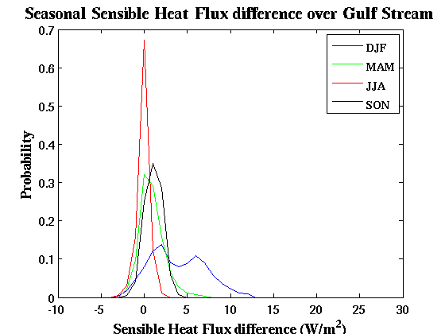
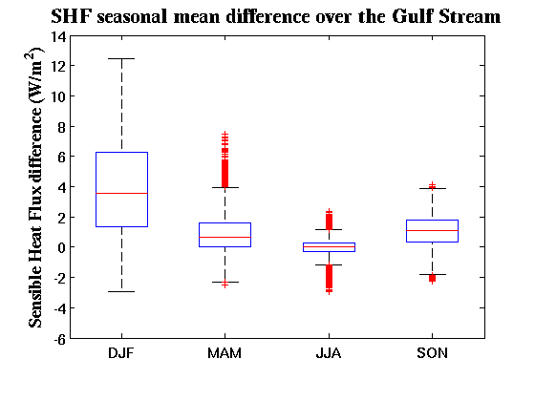
Seasonal SHF
2002-2003 seasonal PDF’s of SHF difference over the Gulf Stream
2002-2003 seasonal box plots of SHF difference over the Gulf Stream
PDFs show seasonally averaged values from each grid point in the domain
Notes:
Explain both figures in detail.

Slide 21
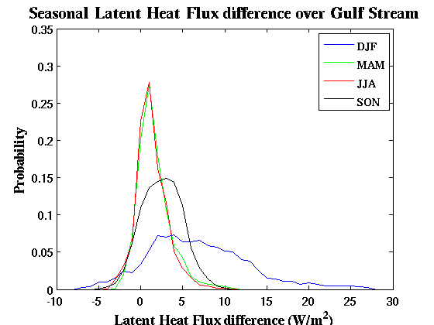
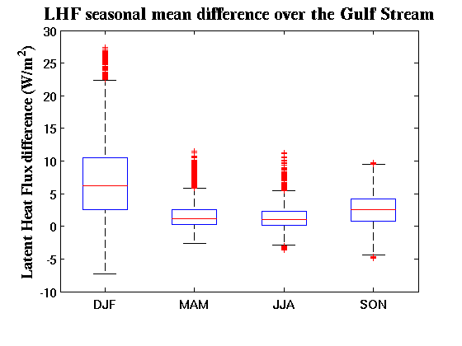
Seasonal LHF
2002-2003 seasonal PDF’s of LHF difference over the Gulf Stream
2002-2003 seasonal box plots of LHF difference over the Gulf Stream
PDFs show seasonally averaged values from each grid point in the domain

Slide 22
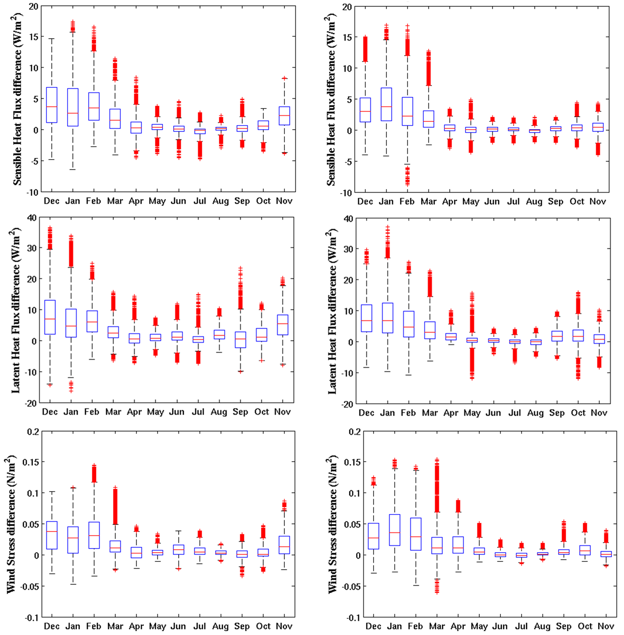
Monthly Box Plots
SHF
SHF
Monthly averaged turbulent flux differences are more sensitive to the background environment
More spatial variability than seasonal averages
Annual cycle is better resolved
LHF
LHF
Dec. 2002 – Nov. 2003 monthly box plots of SHF (top) and LHF (bottom) difference over the Gulf Stream (left) and Kuroshio Extension (right)

Slide 23
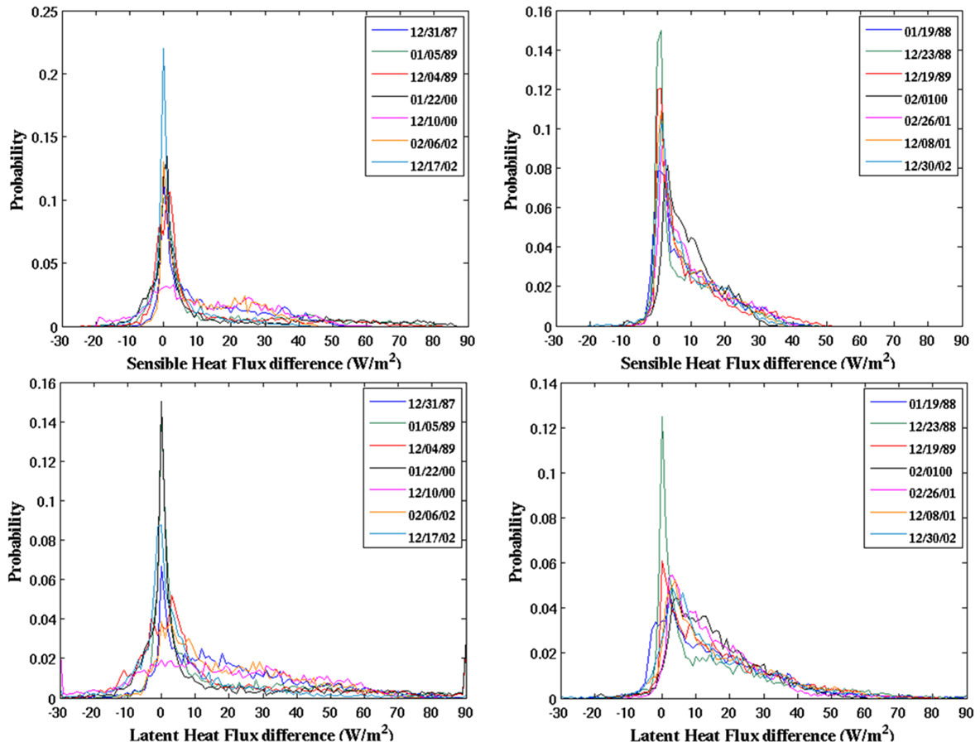
Daily Results
SHF
SHF
Snapshots in the life cycle of individual synoptic-scale events that can impact storm evolution and upper oceanic properties
Despite the same physical process taking place over the Gulf Stream and Kuroshio Extension, PDF shapes are different
LHF
LHF
Daily PDF’s of SHF (top) and LHF (bottom) difference over the Gulf Stream (left) and Kuroshio Extension (right) during selected high wind events

Slide 24
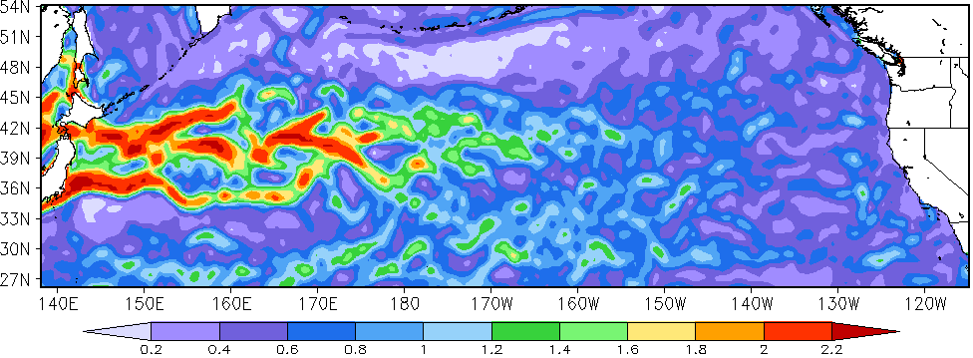
SST Gradients For Upwelling Example
0.2 0.4 0.6 0.8 1.0 1.2 1.4 1.6 1.8 2.0 2.2°C/100km
There are substantial SST gradients over most of the ocean

Slide 25
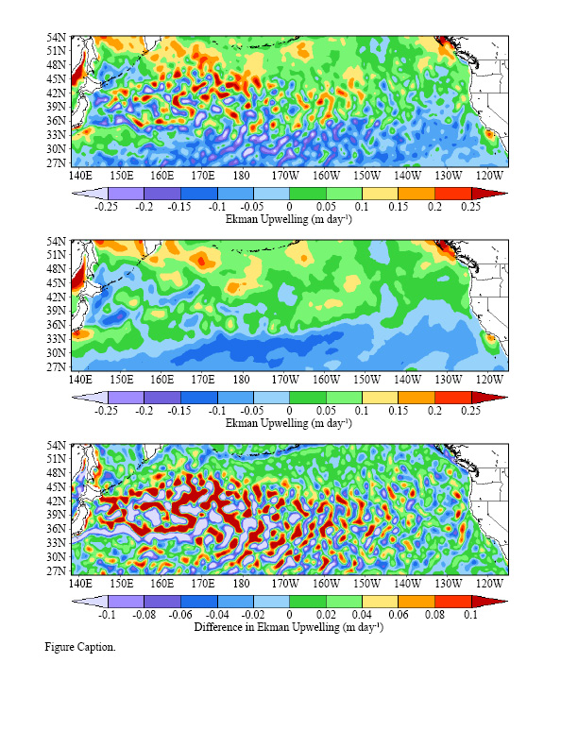
Ekman Upwelling
Baroclinic
Control

Slide 26
Ekman Upwelling Changes
Changes in Ekman Upwelling (Baroclinic case – control)
  These are an order (1) impact
  Many areas with >30% changes

Slide 27
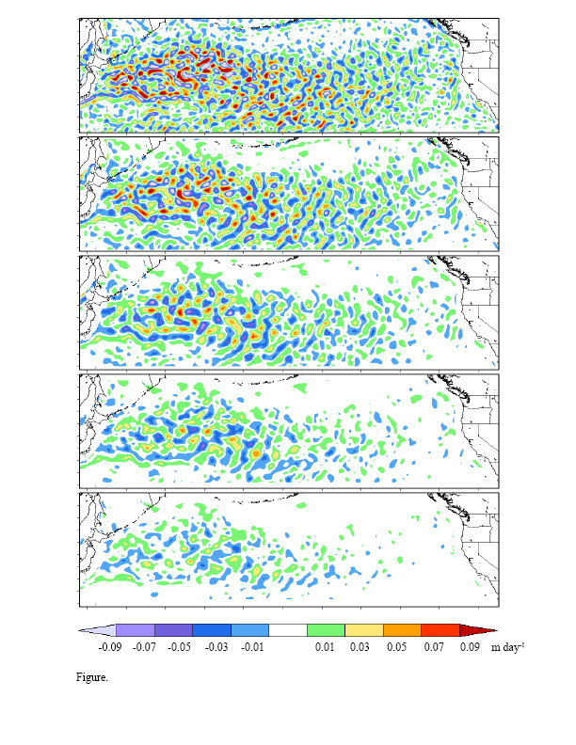
Spatially Band-Pass Filtered Changes
Biggest changes are on scales poorly captured in weather models
Need finer resolution models with better boundary-layers
Note that spatial scale of upwelling areas is smaller than that of downwelling events
We need to couple models on ‘fine’ spatial scales
100 to 200 km
200 to 300 km
300 to 400 km
400 to 500 km
500 to 600 km

