Slide 1
Flux Products Validation by Triple Collocation Methods
and prospects for further studies
Igor Esau, Rick Danielson and Johnny Johannesen
Nansen Environmental and Remote Sensing Centre
Prepared for TIE-OHF meeting at ESRIN, February 8th,2016

Slide 2
Igor Esau (background)
Climatology, meteorology: Climate effects of PBLs
Large-eddy simulations (LESNIC, PALM)
Non-local and self-organized turbulence
Dynamics of the turbulence at air-sea interface
Key publications:
Davy R. and I. Esau, 2014: Global climate models' bias in surface temperature trends and variability, Env. Res. Lett, 9,
Esau I., 2014: Indirect air-sea interactions simulated with a coupled turbulence-resolving model, Ocean Dyn., 64, 689-705
Smedsrud L., I. Esau, R. Ingvaldsen et al., 2013: The role of the Barents Sea in the Arctic climate system, Reviews of Geophysics , 51, 1-35
Esau I. et al., 2013: Structuring of turbulence and its impact on basic features of Ekman boundary layers, NPG, 20, 589-604
Zilitinkevich S. S., Elperin, T., Kleeorin, N., Rogachevskii, I. and I. Esau, 2013: A hierarchy of energy- and flux-budget (EFB) turbulence closure models for stably stratified geophysical flows, Boundary-Layer Meteorology, 146(3), 341-373
Esau, I., 2012: Large scale turbulence structure in the Ekman boundary layer, Geofizika , 29(1), 5-34
Esau, I., 2007: Amplification of turbulent exchange over wide Arctic leads: Large-eddy simulation study, J. Geophys. Res., 112(D), D08109
Zilitinkevich, S. S. and I. Esau, 2005: Resistance and Heat Transfer Laws for Stable and Neutral Planetary Boundary Layers: Old Theory, Advanced and Re-evaluated, Quarterly J. Royal Meteorol. Soc. , 131, 1863-1892
Esau, I., 2004: Simulation of Ekman boundary layers by large eddy model with dynamic mixed subfilter closure, EFM, 4, 273-303

Slide 3
Esau I., 2014: Indirect air-sea interactions simulated with a coupled turbulence-resolving model, Ocean Dynamics, 64, 689-705
Fully coupled turbulence-resolving simulations of joint evolution of OML-ABL convection
PALM code; about 1 mil. CPUh + post-processing
Conclusion: OML-ABL convective eddies are significantly correlated and reinforce each other
gray symbols and thick lines shows the first (circle) and the second (squares) eigenvalues of the analysis between the 55 m
in the ABL and several (−19, −45,
−69, −176 m) levels in the OML
as well as the −45-m level in the
OML and several (5, 55, 115,
215, and 354 m) levels in the
ABL. White upward-looking triangles show the first eigenvalue
of the analysis between 55 m in
the ABL and the other ABL levels, whereas white downward-looking
triangles show the analysis between −45 m in the OML and the other OML levels
45%
Coupled
Uncoupled

Slide 4
Esau, I., 2007: Amplification of turbulent exchange over wide Arctic leads: Large-eddy simulation study, J. Geophys. Res., 112(D), D08109
Atmospheric convection over linear heat source (aka Arctic ice lead)
LESNIC code (good for simultaneous simulations of CBL and SBL in the same domain); 52 runs
Conclusion: Self-organized convection is responsible for stochastic resonance enhancement of the surface heat flux

Slide 5
WP1: Scientific Requirements Consolidation to KO+4
All partners
Consolidation of OHF the requirements including spatial and temporal resolutions, accuracy, input data (basic variables), ancillary data, and error characteristics, format, metadata, online visualization, extraction, and light exploration issues.
1.8 Draft, assemble and deliver the Requirement Baseline (D1.1) J.F Piollé – IFREMER 1.8.2 Review of product evaluation/validation and refinement of the project’s requirements baseline document to be performed that accommodates the interaction with and timeline of similar thematic projects – NERSC
[D.1.1] Requirement Baseline Document – v2 provided
WP2: Reference Data Set Generation to KO+6
K. Haines, A. Andersson, S. Gulev, C. A. Clayson, S. Grodsky, J. Johannessen, R. Pinker, B. Chapron, K. Von Schuckmann
Collection and homogenization of a collection of inputs, turbulent and radiative fluxes and validation data for later product generation and intercomparison
2.1 Gathering and archiving EO (especially from ESA sources) and non EO data as well as satellite L3 and L4 and NWP flux products available during common period of at least 10 years. A. Bentamy – IFREMER 2.1.8 Collecting and providing to Ifremer supplementary Arctic/North Atlantic regional EO and model analysis/forecast variables – NERSC (available upon request)
[D.2.1] OHF Reference data set KO + 6 – v1 provided
Notes:
Task 1.8.2 is a reference to GlobCurrent, but as yet the accommodation of both waves and current aspects remain, at least in part, outside the scope of this project.

Slide 6
WP3: Product Generation, Inter-Comparison and Uncertainty Characterizations to KO+24
A. Andersson, Rainer Hollmann, S. Gulev, C. A. Clayson, S K. Von Schuckmann. Grodsky, J. Johannessen, R. Pinker, K. Haines, C. Merchant, B. Chapron, S. Sathyendranath
a) Develop and test new algorithms, b) generate a “best” product based on on the best selected inputs and algorithms, c) evaluate the quality of the new products, and d) generate an ensemble product
3.3 Evaluation of datasets and error characterization K. Von Schuckmann – MIO 3.3.3 Triple collocation error characterization of input variables to flux calculation. Here, the use of a short-term forecast variable instead of an analysis allows for independence among triple collocations. Simulation of error propagation in bulk flux estimates. Here, corrections to bulk fluxes are derived from an evaluation and intercomparison of the actual fluxes taken from a numerical model and corresponding fluxes obtained with bulk algorithms – NERSC
[D.3.1] Flux Assessment Report KO + 11 [D.3.2] Product Handbook KO + 10 – v1 provided [D.3.3] Flux Product Dataset KO + 10, KO + 24
Error characterization: SHF – completed (see below)
LHF – nearly completed
Ta, SST, qa, U – in work (full attention over the next 3 month)
Notes:
See experiments below

Slide 7
WP5: Strategic Development to KO+24
B. Chapron with A. Bentamy, A. Andersson, Rainer Hollmann, S. Gulev, C. A. Clayson, S K. Von Schuckmann. Grodsky, J. Johannessen, R. Pinker, K. Haines, C. Merchant
Identification of a) opportunities aiming at development of new turbulent flux products, b) new needs and partnerships, and c) synergies with other ongoing projects
5.1 This task aims to identify the most relevant methods and ways for fostering further developments of OHF products and their transition for potential operational use. B. Chapron 5.2 Review and contribute to above task DWD, WHOI, DMUM, PML, IORAS, IFREMER, UR, NERSC
[D.5.1] Scientific roadmap KO + 6, KO + 18
WP6: Project Management and Communication to KO+24
Input from all partners
Provide successful management and control of the OHF project, leading communications, involving user community, reporting to ESA, and timely delivery of all deliverable items.
6.2 Scientific leadership, communication and outreach A. Bentamy – IFREMER 6.2.2 Produce a bi-annual newsletter – NERSC 6.2.3 Produce annual project brochure – NERSC
[D6.1] Outreach material K0+11, KO+24 [D6.2] Final workshop report KO+24 [D6.6] Biannual newsletter Every 6 months [D6.7] Project brochures Every year

Slide 8
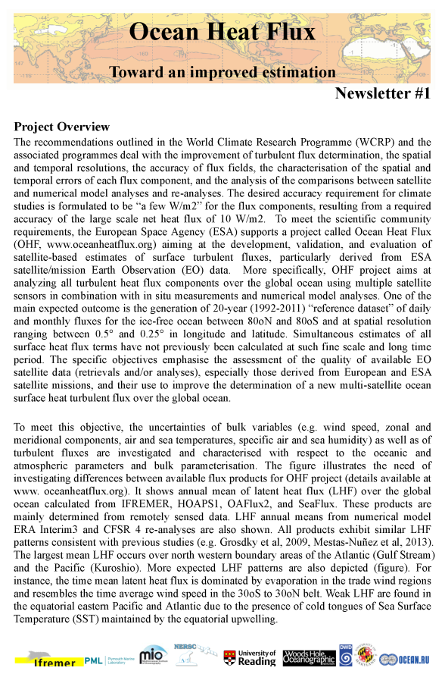
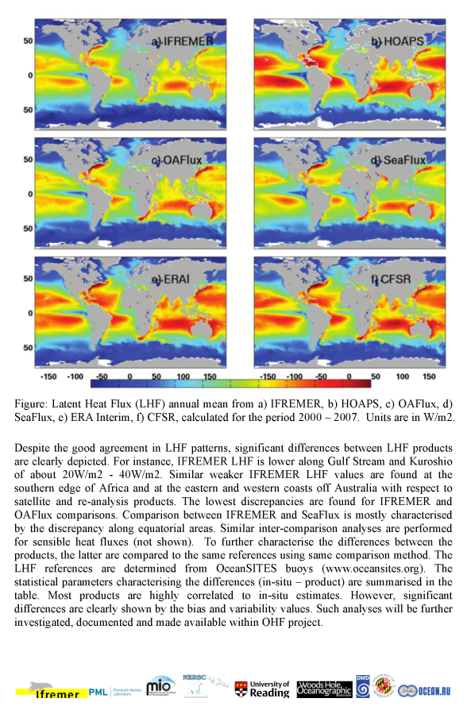
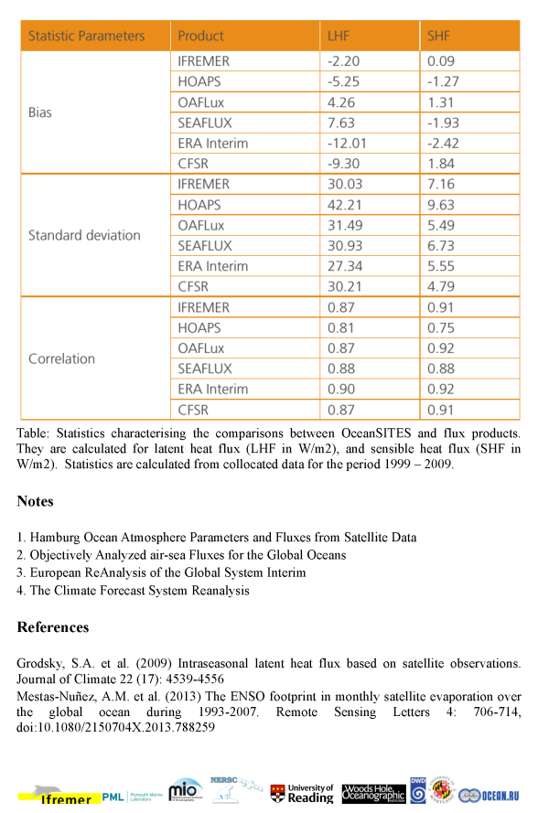
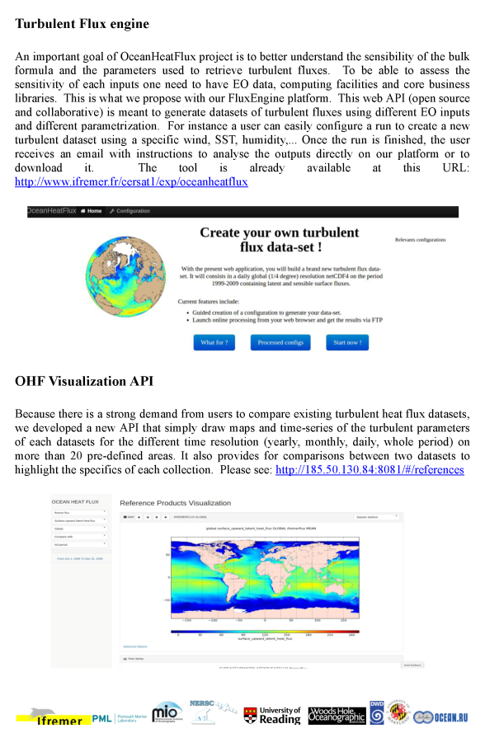
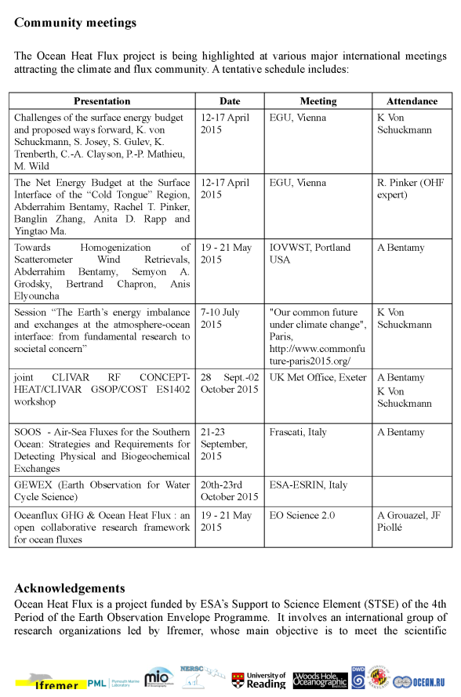
D6.6 Biannual newsletter – v1
Notes:
Contributions received from Abderrahim (reference to SOLAS background article) and Antoine Grouazel (flux engine and API)

Slide 9
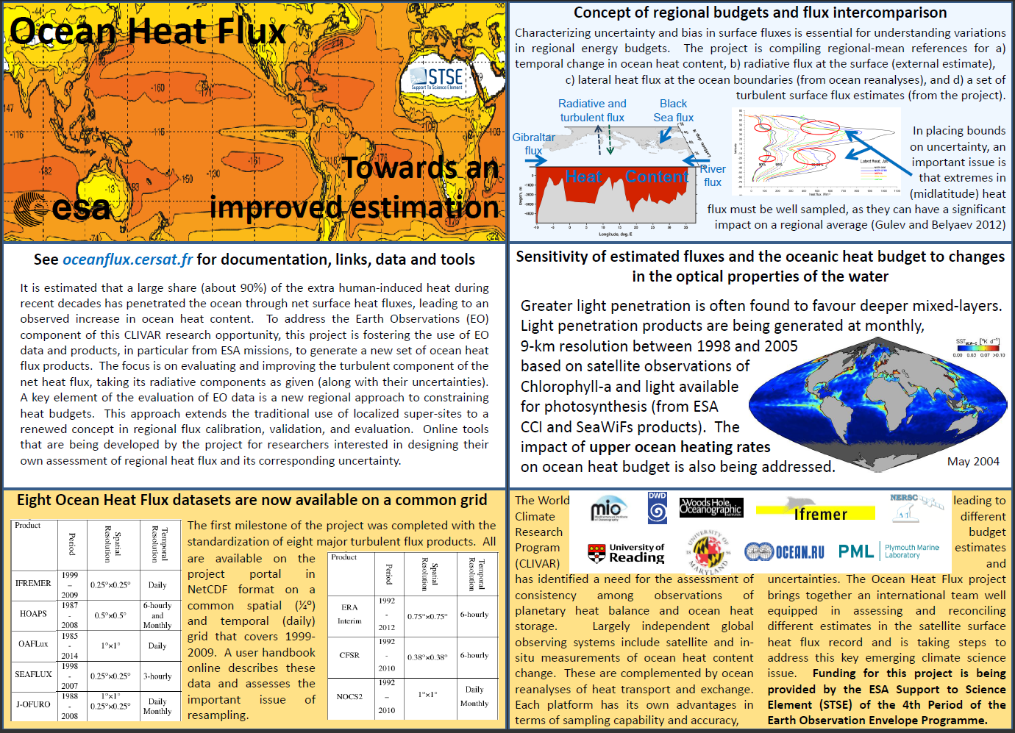
D6.7 Project brochure – v1
Notes:
Feedback received from Antoine Grouazel (website link is updated)

Slide 10
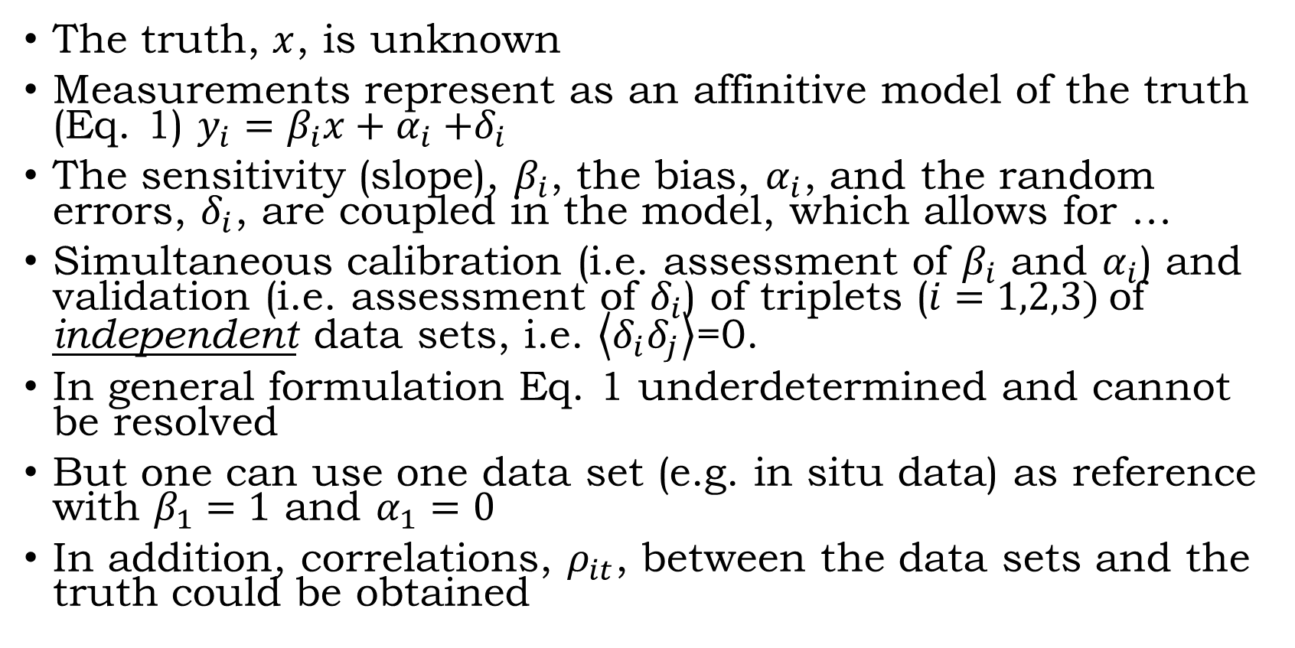
Triple Collocation Method
The truth, $x$, is unknown
Measurements represent as an affinitive model of the truth (Eq. 1) $y_{i}=β_{i}x+α_{i}{+δ}_{i}$
The sensitivity (slope), $β_{i}$, the bias, $α_{i}$, and the random errors, $δ_{i}$, are coupled in the model, which allows for …
Simultaneous calibration (i.e. assessment of $β_{i}$ and $α_{i}$) and validation (i.e. assessment of $δ_{i}$) of triplets ($i=1,2,3)$of independent data sets, i.e. $\left\langle δ_{i}δ_{j}\right\rangle$=0.
In general formulation Eq. 1 underdetermined and cannot be resolved
But one can use one data set (e.g. in situ data) as reference with $β_{1}=1$ and $α_{1}=0$
In addition, correlations, $ρ_{it}$, between the data sets and the truth could be obtained

Slide 11
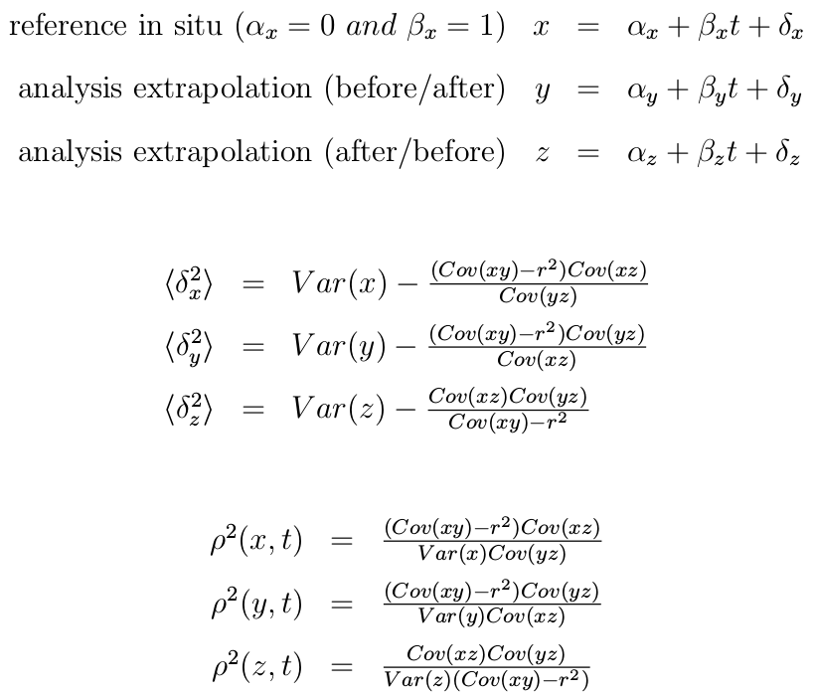
Implementation
CFSR
In situ
(calibrated, unbiased)
ERA Interim
HOAPS
Ifremer v4
J-OFURO
MERRA
OAFlux
SeaFlux
Time
In total: 8 data sets + in situ (ref) data
Var(a) = <a²> - <a>²
Cov(ab) = <ab> - <a><b>
RMS error (Stoffelen 1998)
Correlation and signal-to-noise ratio (McColl et al. 2014)
Notes:
Extrapolation one day ahead/behind is insensitive to the number of days used if extrapolation employs O[10 days].

Slide 12
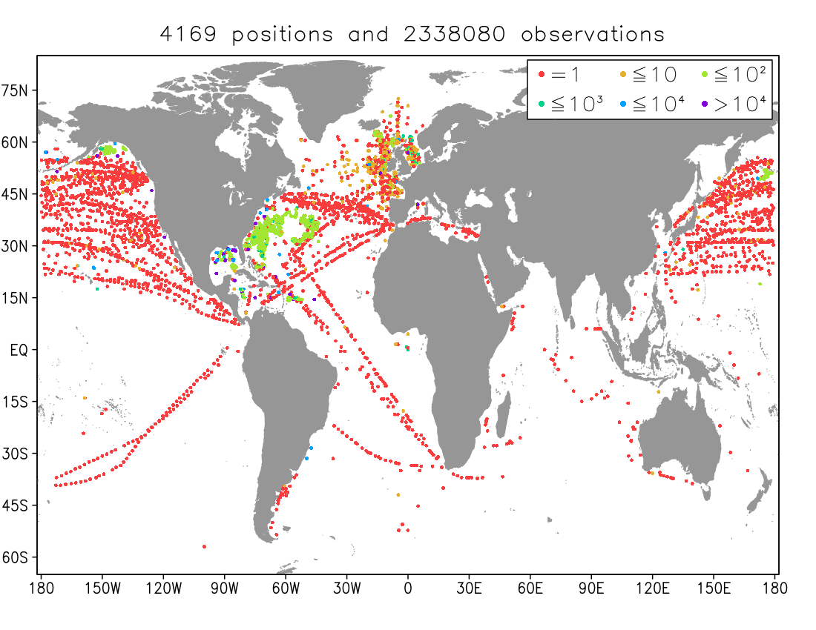
In situ data
Ship and buoy observations that were transmitted in real time between October 1999 and December 2009 and archived at ftp.ncdc.noaa.gov/pub/data/ncep_gts
(reduced coastal and no inland water sites)
next slide
Location and number of in situ observations that permit a COARE4
calculation of heat flux
Daily averages were obtained
OceanSites data are largely
independent
Notes:
Fig. 1: Number of ship and buoy observations (order of magnitude in colour) that were transmitted in real time between October 1999 and December 2009, as taken from an operational archive at ftp.ncdc.noaa.gov/pub/data/ncep_gts. Coastal and inland water sites with poor coverage by the eight analyses (see text) are omitted. Shown are values at the ¼degree resolution of the project’s reference grid.

Slide 13
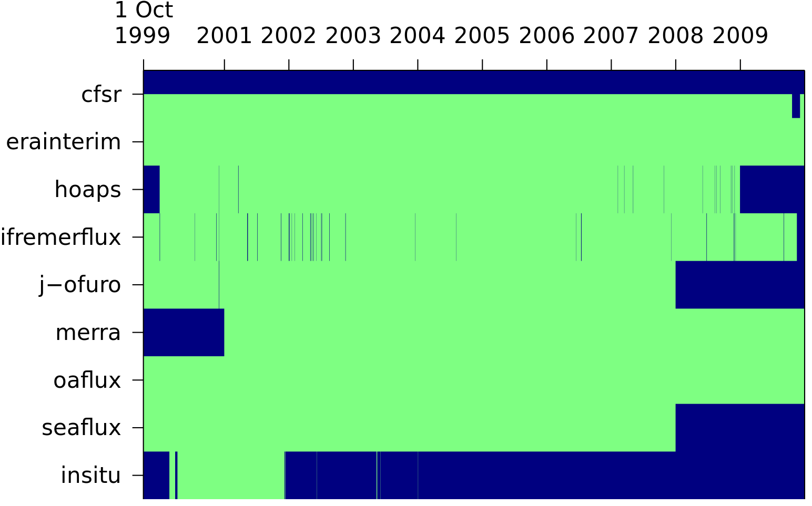
In situ and analysis collocation
Example of daily latent and sensible heat flux
coverage at 55N and 12.5W (in the north Atlantic)
CFSR latent heat flux is missing
Collocations occur during
2001-2007
SHF spectra (next slide)
are derived after all analysis gaps are mapped to all analyses
LHF
SHF
Available daily fluxes
(with gaps; green)
LHF
SHF
LHF
SHF
Notes:
Fig. 2: Temporal coverage of daily sensible and latent heat flux values at 55N and 12.5W (in the north Atlantic; missing values are in blue) for eight reference datasets and in situ data between 1 October 1999 and 31 December 2009. Respectively, latent and sensible flux (gridded v0.6f01.0) are shown above and below each dataset label on the left (i.e., CFSR latent heat flux is the only one entirely missing).

Slide 14
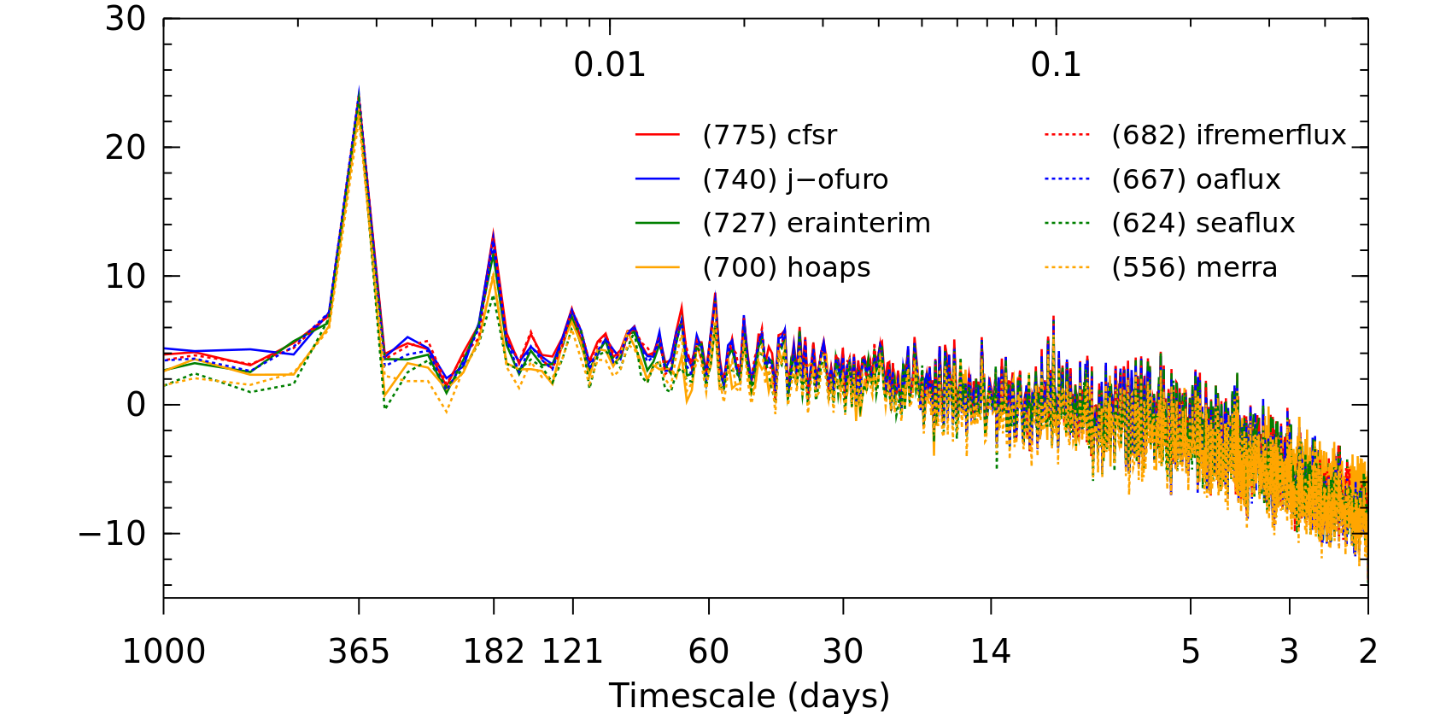
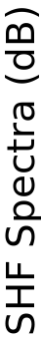
Results
In situ observations enhance variability of all analyses on all scales
Submonthly range is 219 W²m⁻⁴ (775 – 556)
vs uncalibrated 294 W²m⁻⁴ (717 – 423)
integrated submonthly variability (W²m⁻⁴)
Notes:
Fig. 4: As in Fig. 3, but for spectra rescaled using the parameters alpha and beta from Table 1.

Slide 15
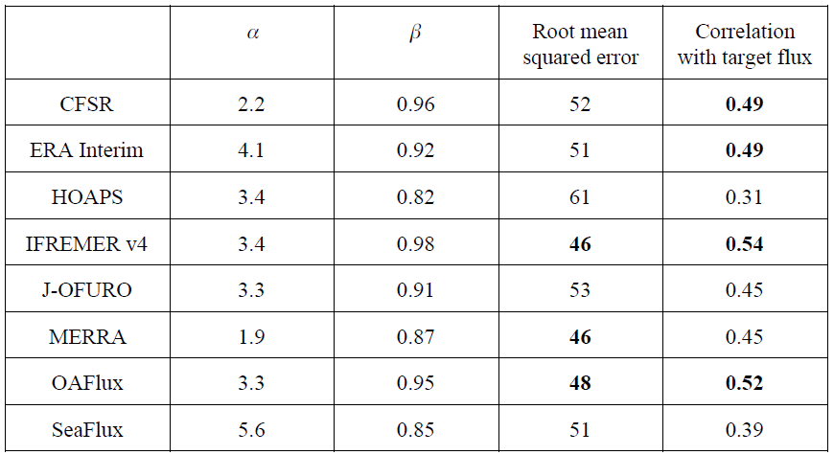
Analysis calibration/performance metrics
(bias)
(scale)
Notes:
Table 1. Average RMSE and idealized target heat flux correlation for the analysis that is taken to be least familiar (i.e., both the in situ observations and, in turn, each of the other seven analyses are used for reference and the seven results are then averaged). The top three values in both categories are listed in bold, but note that each statistic is reported with reference to the resolution of the analysis in question (cf. calibrated individual spectra in Fig. 4).

Slide 16
Work Plan
OceanSites remains largely independent and can still be employed for validation, as we are doing in the project now but for recalibrated analyses (good validation of the approach itself) – 30h
Triple collocation characterization of input variables (Ta, SST, U, qa) –150h
Brochure, newsletter, roadmap (article) – 100h
Action 9: Felyx collocation statistics incorporation (available at https://github.com/rickedanielson/diag.heat.flux) – 50h

Slide 17
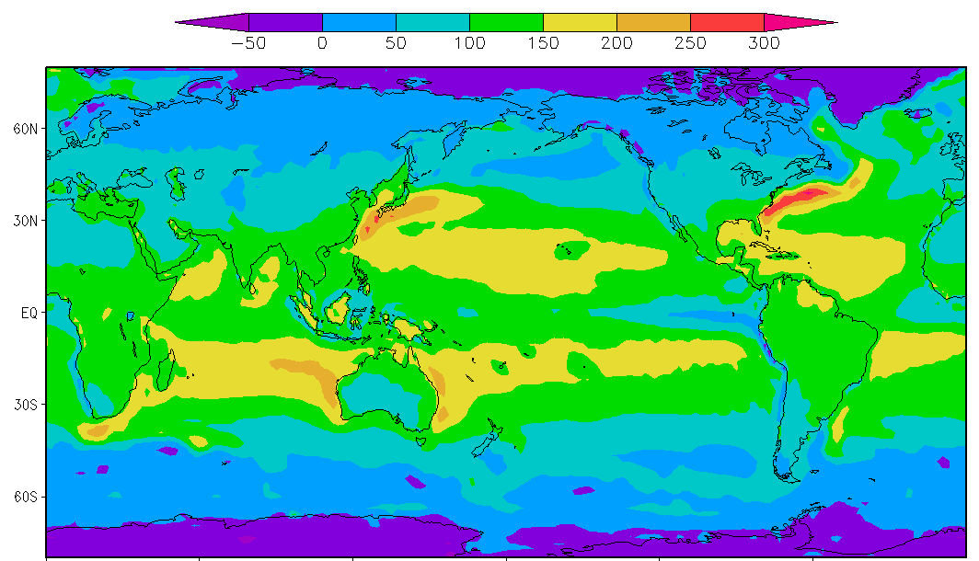

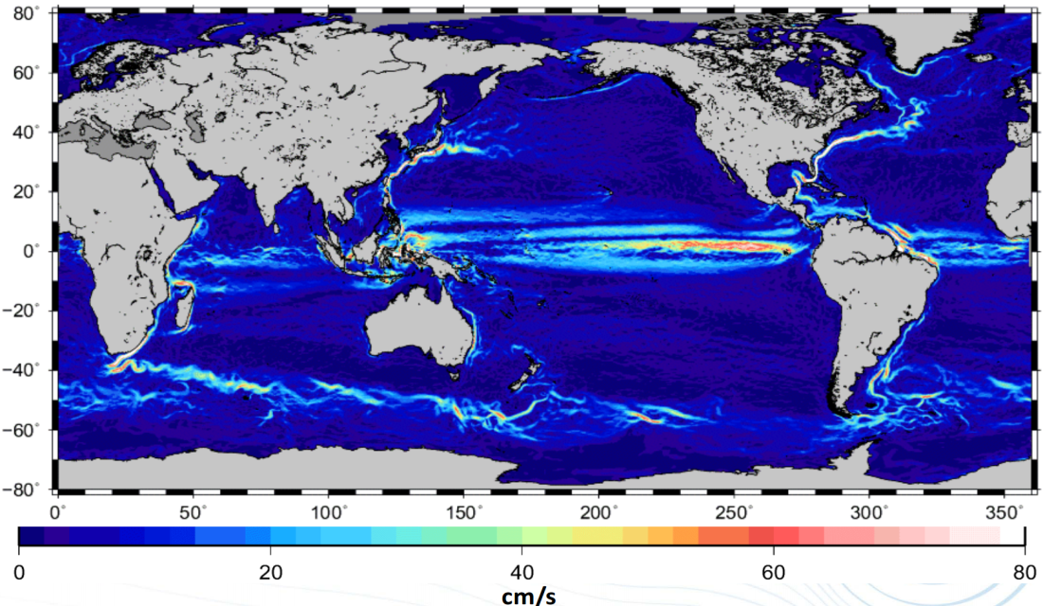
OHF roadmap
long term
mean surface
heat flux
long-term
mean
geostrophic
current
major western boundary currents and upward heat flux maxima are well collocated
currents
also identify
other regions where ocean heat content change is of interest

