Slide 1

Development on the “concept of cages”
K. von Schuckmann, A. Andersson, S. Gulev, J. Trendmann, K. Haines, M. Valdivieso
ESA-OHF meeting, 18.09.2015

Slide 2
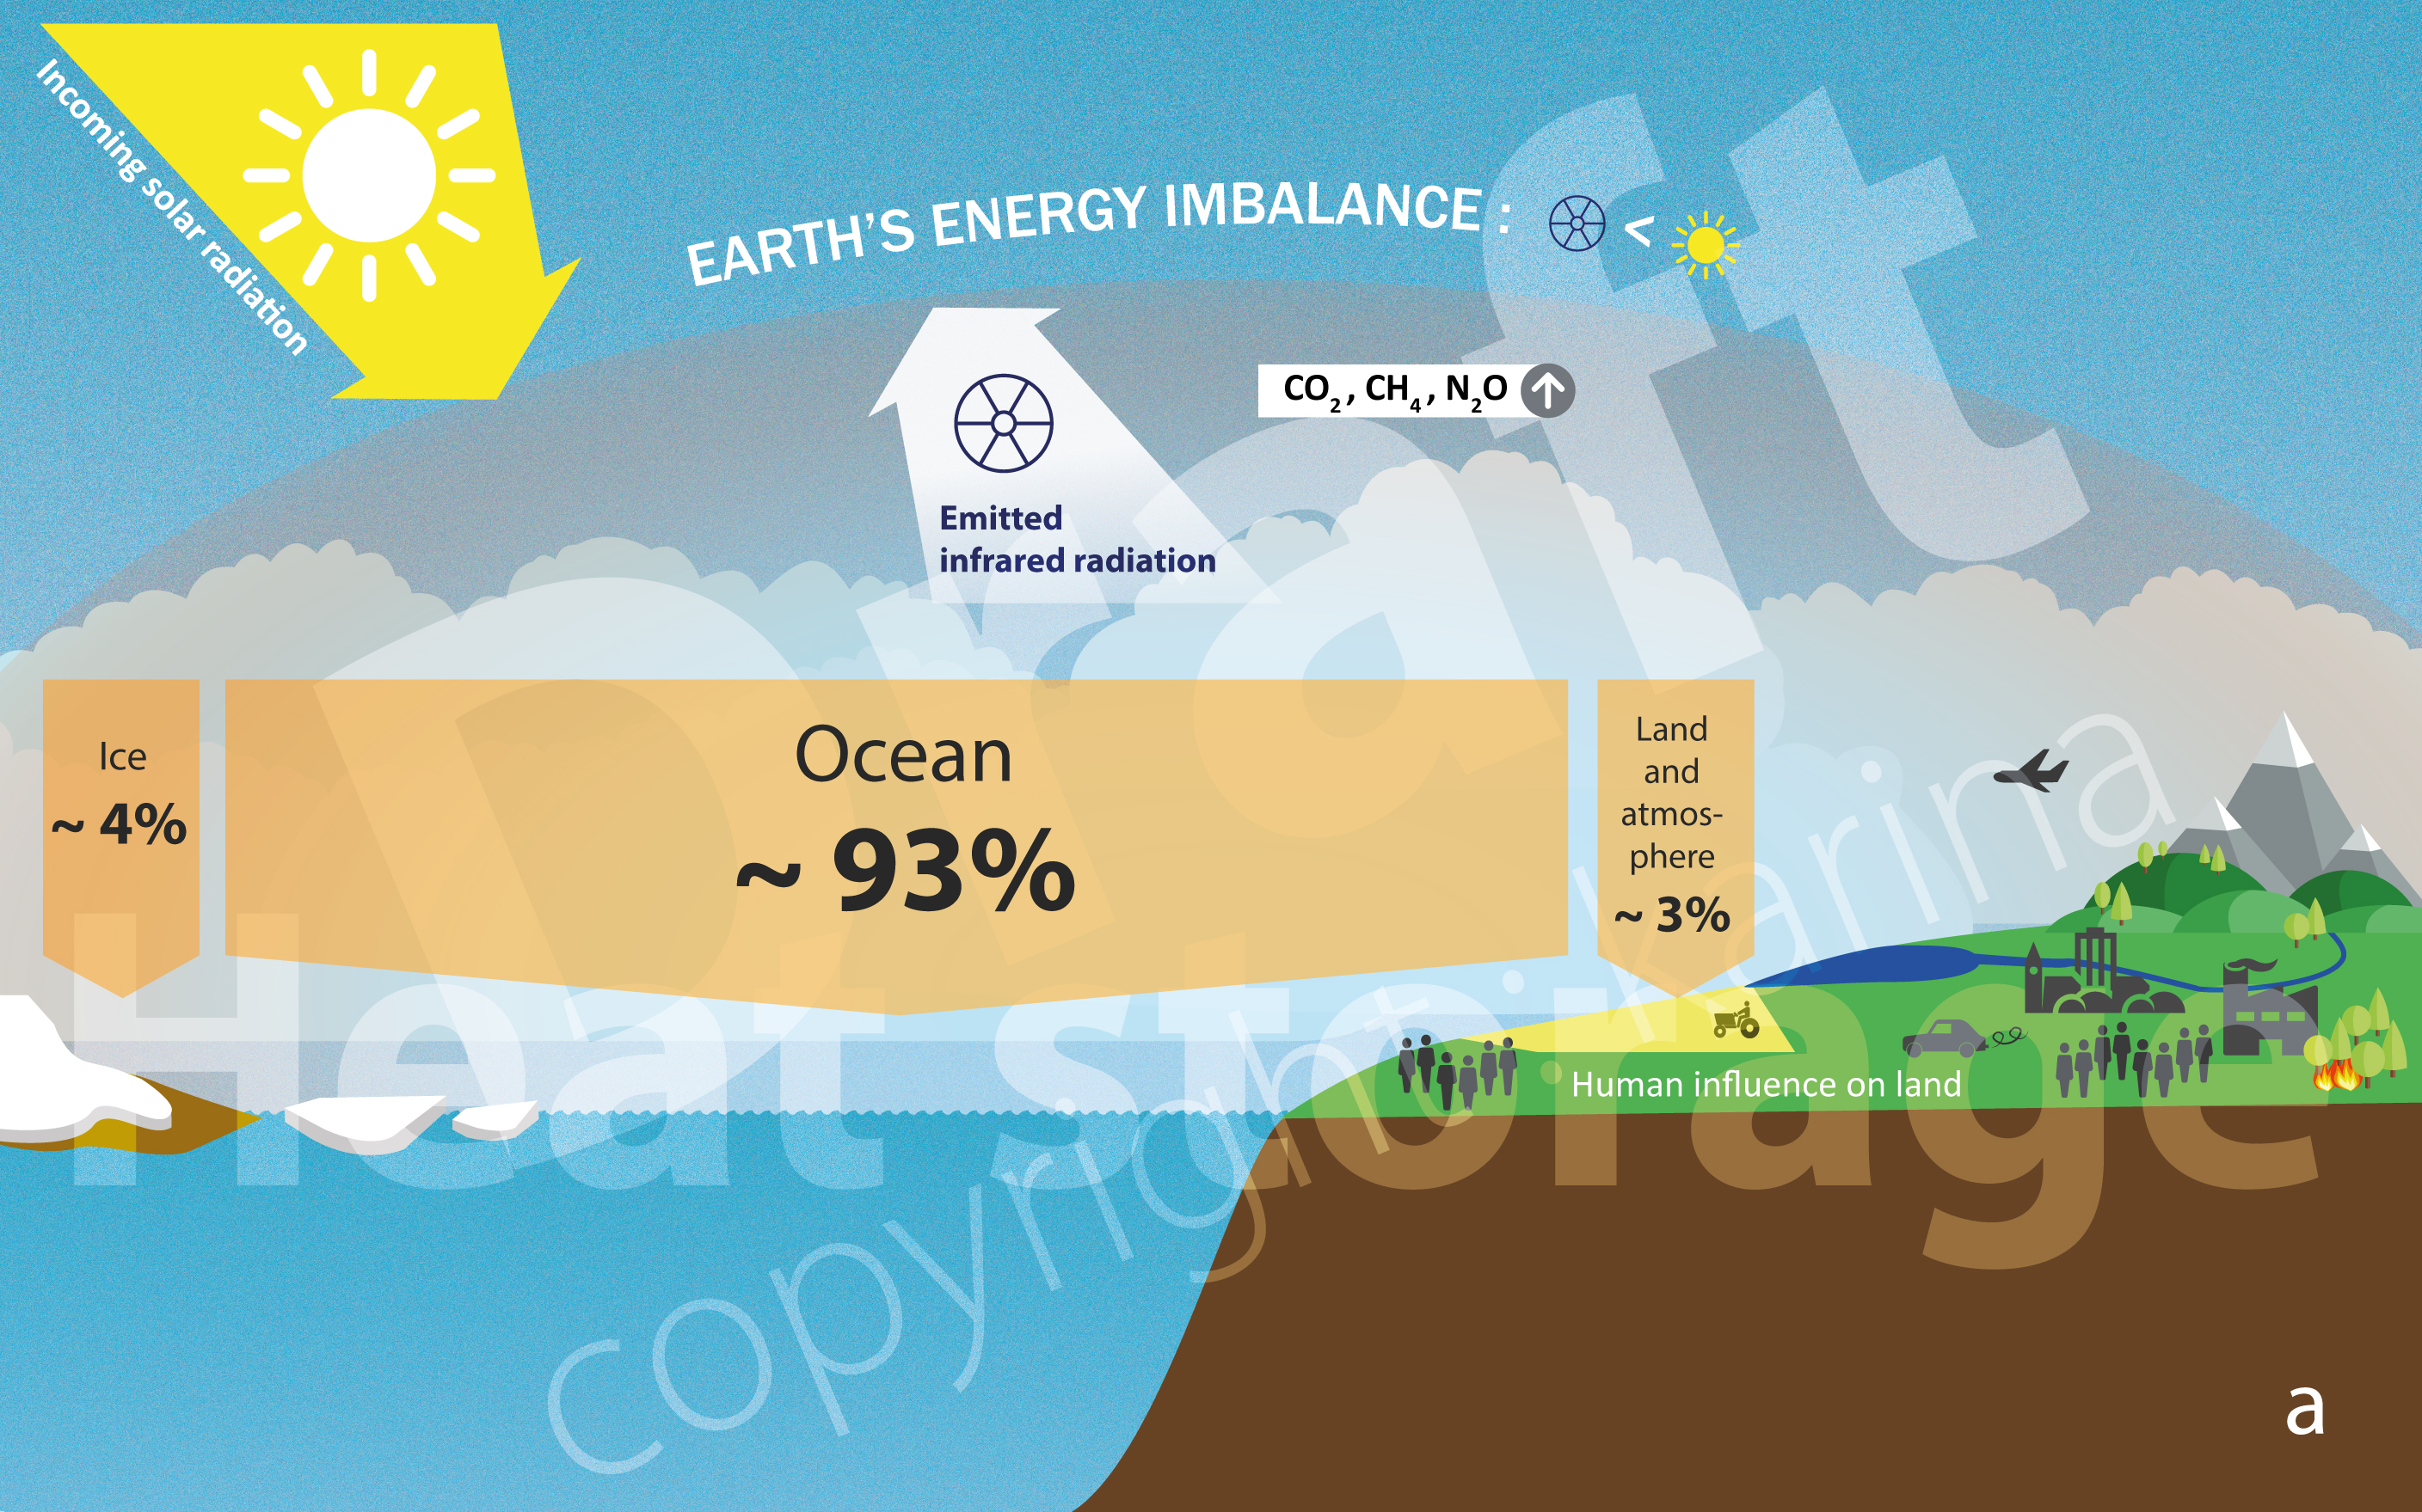
Positive Earth’s Energy Imbalance: accumulation of heat in the climate system
Von Schuckmann et al., 2015 (Nature Climate Change, under revision)

Slide 3
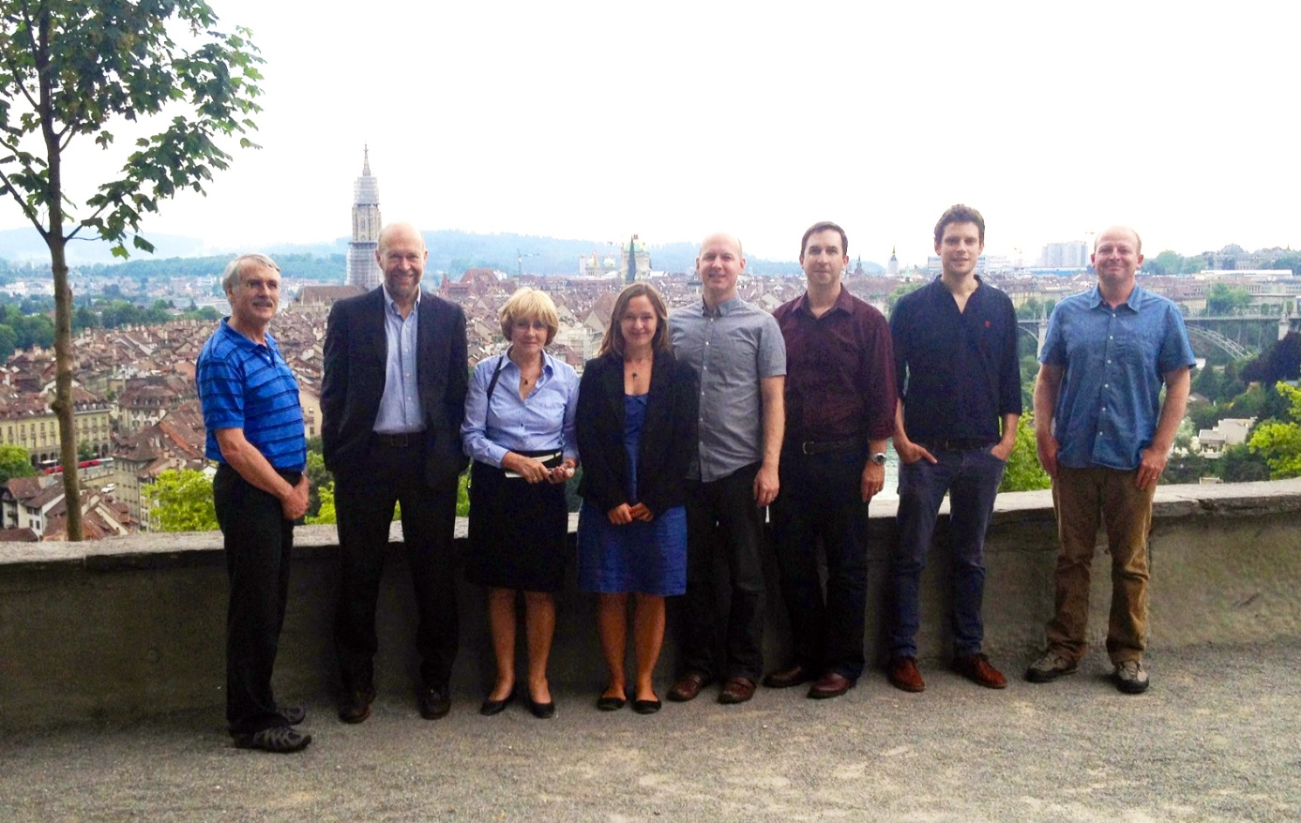
Earth’s Energy Imbalance. Currently +0.5 to 1 Wm⁻²
The absolute measure of the Earth Energy Imbalance and its changes over time are vital pieces of information related to climate change as this is the single quantity defining the status of global climate change and expectations for continued global warming.
ISSI working group: “Consistency of Integrated Observing Systems monitoring the energy flows in the Earth System”
First meeting June 2014
Second meeting June 2015
K. von Schuckmann
A. Cazenave, D. Chambers,
J. Hansen, S. Josey,
N. Loeb, P.P. Mathieu, B. Meyssignac, M. Palmer, K. Trenberth, M. Wild
Perspective paper submitted to NCC (von Schuckmann et al., 2015)

Slide 4
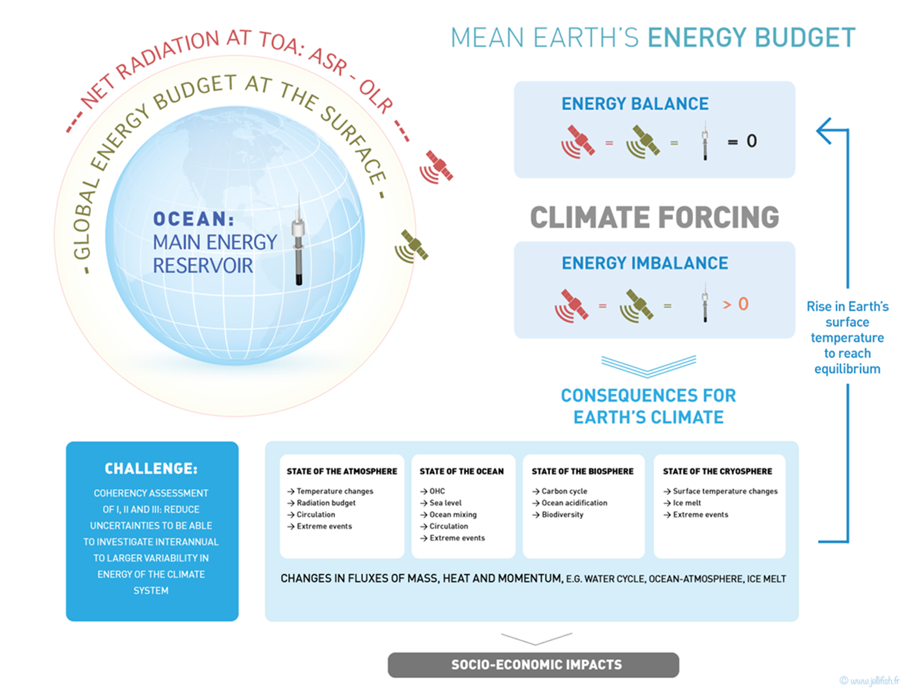
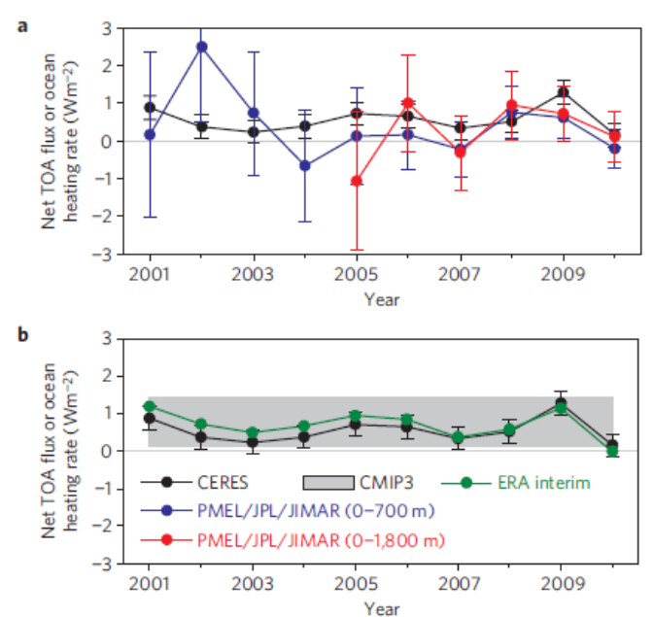
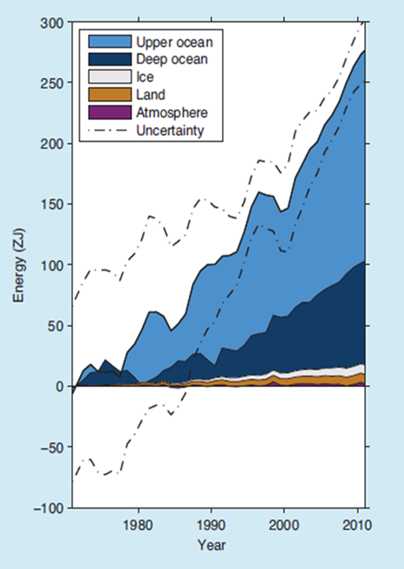
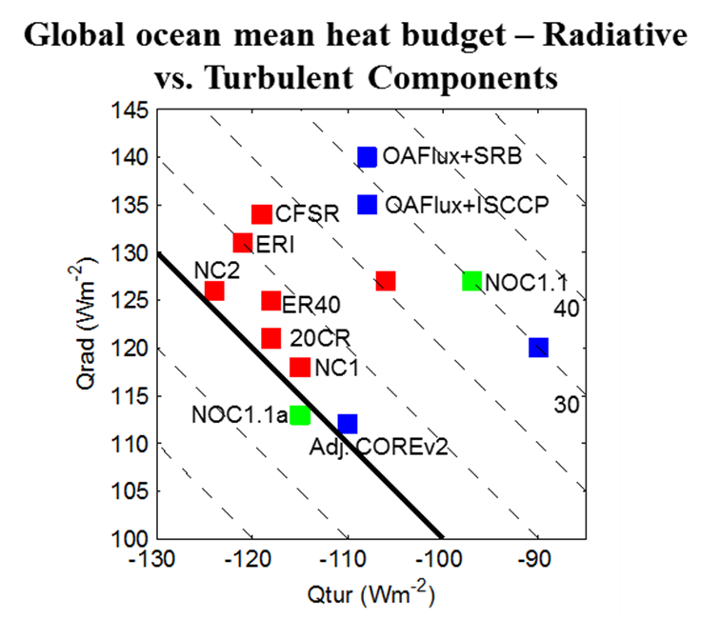
Determining Earth’s energy imbalance: Three methods
Radiation at TOA
METHOD I
Loeb et al., 2012
Ocean Heat Content
Air-Sea fluxes
METHOD II
METHOD III
radiative
Global ocean ➔ largest heat reservoir of the climate system
Josey et al., 2015
turbulent
IPCC, 2013

Slide 5
Determining Earth’s energy imbalance: METHOD III – Air-Sea fluxes
Courtesy: S. Josey
Global Heat Budget Closure : Overview
Wide spread of products ➔ heat budget closure remains a significant problem.
Satellite net radiative fluxes (135-140 Wm⁻² SRB, ISCCP) typically exceed those of other products by 10-20 Wm⁻².
OAFlux+SRB/ISCCP inability to close global heat budget driven in large part by radiative terms.
New generation reanalyses have poorer global closure than previous products.
NOC and CORE adjustments result in similar solutions.
How do we move towards a reliable balanced product? Surface mooring array based evaluations? Ocean and/or coupled ocean-atmosphere reanalyses?
Uncertainty across products: radiative flux 112 to 140 Wm⁻², turbulent flux -90 to -124Wm⁻².
Example showing the wide spread of different products
Global ocean mean heat budget – Radiative vs. Turbulent Components
OAFlux+SRB
OAFlux+ISCCP
CFSR
50
ERI
MERRA
NC2
NOC1.1
ER40
40
20CR
NC1
Unadj. COREv2
NOC1.1a
30
Adj. COREv2
-20
-10
20
Qnet=0
10
Notes:
Worth noting that at present the WHOI OA do not provide fields of the variables used to derive the fluxes. This limits our ability to evaluate this product.

Slide 6
Determining Earth’s energy imbalance: METHOD III – Air-Sea fluxes
Courtesy: S. Josey
Global Heat Budget Closure : Overview
Wide spread of products ➔ heat budget closure remains a significant problem.
Satellite net radiative fluxes (135-140 Wm⁻² SRB, ISCCP) typically exceed those of other products by 10-20 Wm⁻².
Global ocean heat budget closure. Still a long way from obtaining well-based closure of the budget, products tend to be biased warm by 10-25 Wm⁻². Bias is probably due to multiple sources of error at the 2-5 Wm⁻² level.
OAFlux+SRB/ISCCP inability to close global heat budget driven in large part by radiative terms.
New generation reanalyses have poorer global closure than previous products.
NOC and CORE adjustments result in similar solutions.
How do we move towards a reliable balanced product? Surface mooring array based evaluations? Ocean and/or coupled ocean-atmosphere reanalyses?
Uncertainty across products: radiative flux 112 to 140 Wm⁻², turbulent flux -90 to -124Wm⁻².
Global ocean mean heat budget – Radiative vs. Turbulent Components
OAFlux+SRB
OAFlux+ISCCP
CFSR
50
ERI
MERRA
NC2
NOC1.1
ER40
40
20CR
NC1
Unadj. COREv2
NOC1.1a
30
Adj. COREv2
-20
-10
20
Qnet=0
10
Notes:
Worth noting that at present the WHOI OA do not provide fields of the variables used to derive the fluxes. This limits our ability to evaluate this product.

Slide 7
CONCEPT of CAGES
However, characterizing the uncertainty and biases in fluxes is essential to address scientific challenges related to the Earth Energy budget, energy flows, and understanding the observed shorter-term interannual to decadal fluctuations (e.g., recent “hiatus” period) superimposed on the centennial-scale warming of the global ocean surface
Recommendation to step from “local validation” to “regional validation”
CONCEPT of CAGES
(Bretherton et al., 1982; Yu et al., 2012; WCRP, 2013)
The most power-full issue for the “cage approach” is that independent climate observing systems and tools are compared and set into the constraint of the physical budget for each defined ocean box.

Slide 8
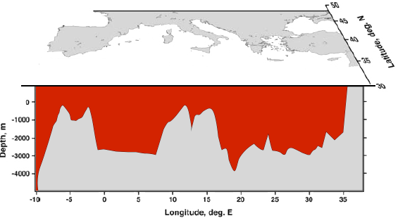
Recommendation to step from “local validation” to “regional validation”
CONCEPT of CAGES (Bretherton et al., 1982; Yu et al., 2012; WCRP, 2013)
Radiative and turbulet fluxes
Lateral flux
– d(OHC)/dt
Budget
Flux net
atmos.
Flux net at Gibraltar
OHC
T₀ = T - T_{clim}
HB = (SW↓ − SW↑ + LW↓ − LW↑) + Lhf + Shf
Lhf = latent heat flux; Shf=Sensible heat flux
SW (0.3-4.0 µm) and LW (4.0-100.0 µm) are the shortwave and longwave components respectively, and arrows represent the direction of the flux .
The various OHB components are available for OHF project.
Notes:
<number>

Slide 9
Recommendation to step from “local validation” to “regional validation”
CONCEPT of CAGES (Bretherton et al., 1982; Yu et al., 2012; WCRP, 2013)
Radiative and turbulet fluxes
Lateral flux
– d(OHC)/dt
Budget
Flux net
atmos.
Flux net at Gibraltar
OHC
T₀ = T - T_{clim}
Estimates of physical budget components to implement the approach:
1. a reference estimates of box mean temporal changes for OHC
2. one reference of box mean radiative flux estimate
3. one reference estimate of lateral HF at the boundaries of each box
4. a set of box mean turbulent fluxes from the “OHF reference data set”
Notes:
<number>

Slide 10
Recommendation to step from “local validation” to “regional validation”
CONCEPT of CAGES (Bretherton et al., 1982; Yu et al., 2012; WCRP, 2013)
Radiative and turbulet fluxes
Lateral flux
– d(OHC)/dt
Budget
Flux net
atmos.
Apply this to the global ocean (1992-2010)
Division global ocean in 10°x10° ocean boxes (60°S-60°N)
Temporal resolution: decadal (2005-2012 trend), and annual means
Expected outcome:
Assessment plots (scatter) of turbulent flux products for each region and for different temporal resolution)
Map of std of “spread” from different flux products
Flux net Black Sea
Flux net at Gibraltar
Flux from river runoff
OHC, OFC
Estimates of physical budget components to implement the approach:
1. a reference estimates of box mean temporal changes for OHC
2. one reference of box mean radiative flux estimate
3. one reference estimate of lateral HF at the boundaries of each box
4. a set of box mean turbulent fluxes from the “OHF reference data set”
Notes:
<number>

Slide 11
CONCEPT of CAGES
Estimates of physical budget components to implement the approach:
a reference estimates of box mean temporal changes for OHC: K. von Schuckmann (MIO): software developped
2. one reference of box mean radiative flux estimate: J. Trendmann (DWD): discussion on analysis May 2015 (visit at DWD)
3. one reference estimate of lateral HF at the boundaries of each box: K. Haines, M. Valdivieso (Univserity of Reading): Discussion on phone, May, 2015
4. a set of box mean turbulent fluxes from the “OHF reference data set”: A. Andersson (DWD): discussion on analysis May 2015 (visit at DWD)
General discussion on method development: MIO and IORAS, July 2015

Slide 12
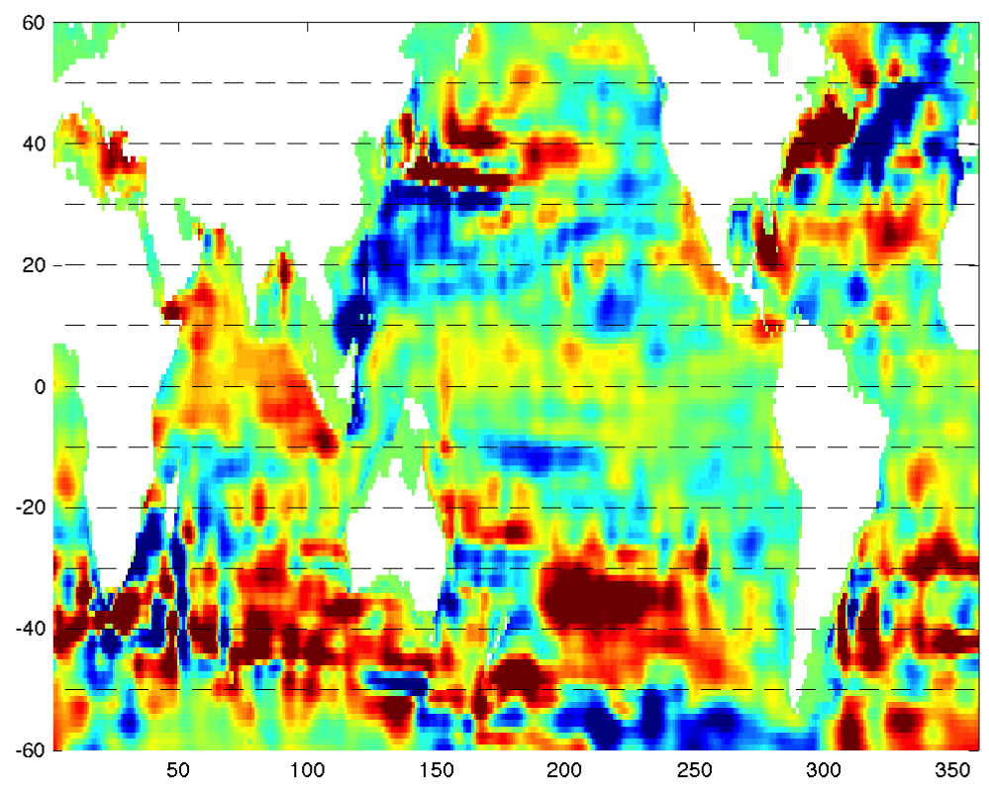
Recommendation from various community discussions (MIO, DWD, IORAS, Met Office, NOC, UR, Ifremer, NCAR)
Map of regional OHC trends (2005-2012, 0-2000m depth)
Divide the global ocean into 10° latitude sections between 60°S-60°N

Slide 13
Recommendation from various community discussions (MIO, DWD, IORAS, Met Office, NOC, UR, Ifremer, NCAR)
Uncertainty assessment of turbulent flux products under physical budget constraint visualized in a scatter plot for each region/box (2005-2012 trend, and annual means)
d(HB)/dt
d(OHC)/dt – HF (lateral)
This uncertainty assessment can be performed on the Ifremer/OHF portal after delivery of the different components 1.-4.

Slide 14
4 parameters need to be prepared and delivered to perform an error assessment for different turbulent fluxes
Estimates of physical budget components to implement the approach:
a reference estimates of cage mean (latitude band) temporal changes for OHC
2. one reference of box mean radiative flux estimate
3. one reference estimate of lateral HF at the boundaries of each box
4. a set of box mean turbulent fluxes from the “OHF reference data set”

Slide 15
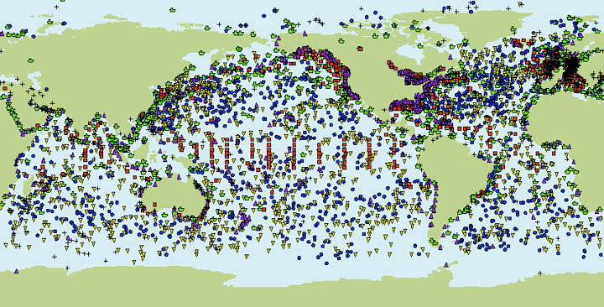
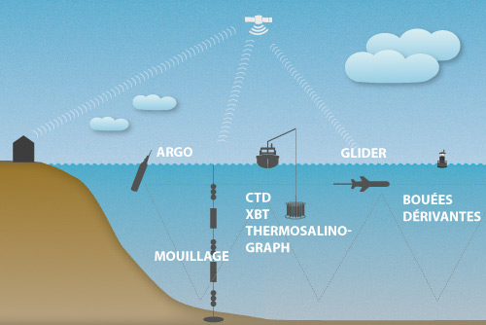
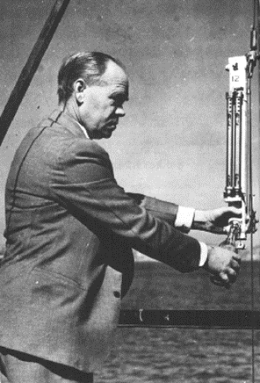
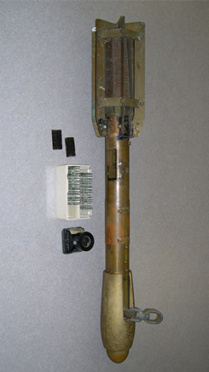
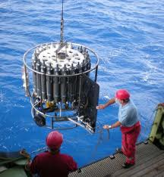
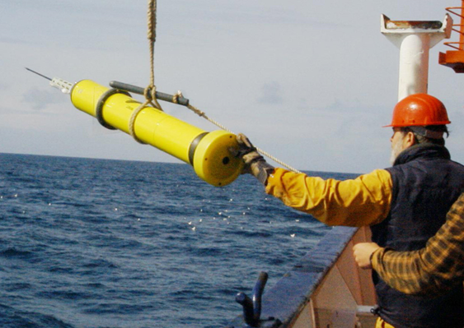
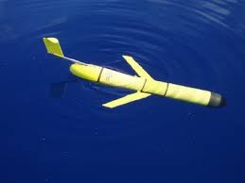
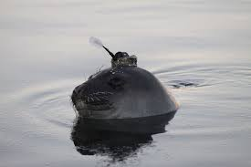
1. A reference estimates of box mean temporal changes for OHC
Main historical obs.:
Pre-1970 (Mechanical BathyThermograph (MBT) Gold standard (Reversing therm) )
Argo era:
2000-now: 95% Argo profiling floats, shipboard measurements, moorings, gliders, instrumented marine mammals, etc.
1971–2003 (eXpendable Bathy-Thermograph (XBT) Gold standard ship board CTD

Slide 16

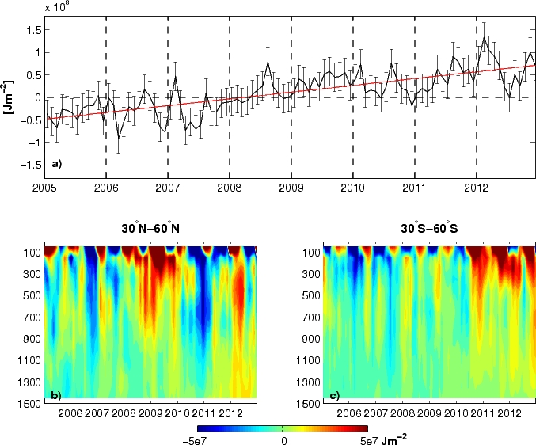
1. A reference estimates of box mean temporal changes for OHC
In situ data source:
CORA dataset
Programs, documentation and OHC time series and trends have been delivered to Ifremer in August 2015
Method for OHC calculation:
Global Ocean Heat Content
trend 2005-2012: 0.5±0.1 Wm⁻²
von Schuckmann et al., 2014
➔ Validated through physical budget constraint (sea level budget)

Slide 17
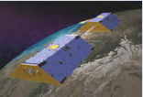
1. A reference estimates of box mean temporal changes for OHC
OHC method validation through physical budget constraint (von Schuckmann et al., 2014)
SL_{steric}(Argo) + SL_{res} = SL_{total} – SL_{mass}
Changes below Argo depths
&
Estimation errors (sampling and processing issues, systematic biases)
Argo: Altimetrie: GRACE:
2000-2012 1993-2012 2002-2012
Overlapping time window for global and re-qualified data 2005-2010: Methods developed for global estimations
von Schuckmann and Le Traon, 2011
Averaged DM gridded product, AVISO
Chambers and Schröter, 2011
Notes:
<number>

Slide 18
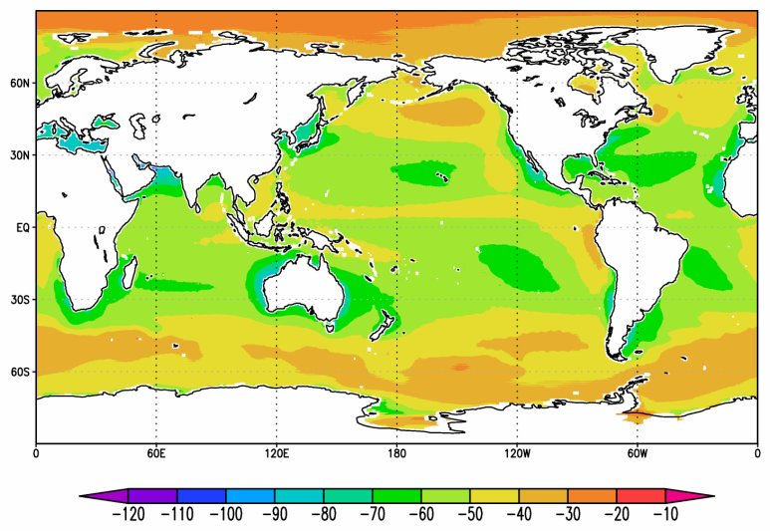
2. One reference of box mean radiative flux estimate
CM SAF CLARA :: Climate Mean 1982-2009 :: Surface Net Longwave [W/m²]
Surface Radiation Data Sets
Satellite:
ISCCP (1983-2009)
SRB (1983-2007)
CM SAF CLARA (1983-2009)
Reanalysis:
ERA interim, CFSR (-2015)

Slide 19
3. One reference estimate of lateral HF at the boundaries of each box
Lateral heat flux at sections from ocean reanalysis: University of Reading and/or mercator (copernicus)
Please add details and interact with Ifremer for data exchange so that they can perform the scatter plots

Slide 20
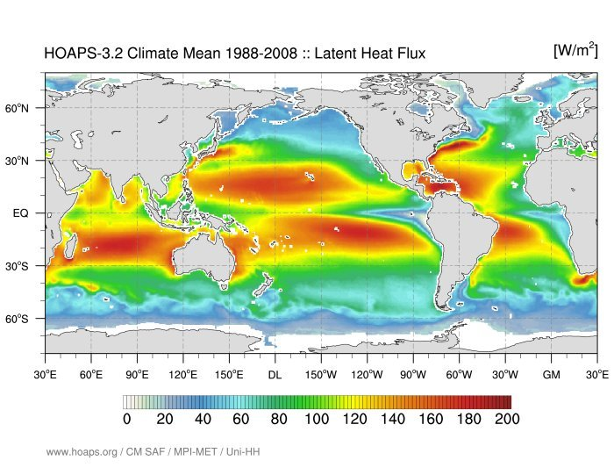
4. A set of box mean turbulent fluxes from the “OHF reference data set”
Turbulent Flux Data Sets
Satellite:
HOAPS (1988-2008 / 2012)
IFREMER (1999-2009)
Seaflux (1988-2008)
J-OFURO (1988-2008)
Reanalysis:
ERA interim, CFSR (-2015)
Hybrid:
OAFlux (1958-2014)
➔ Collaboration Ifremer/DWD, OHF portal

Slide 21

Clivar research focus CONCEPT-HEAT:
Consistency between planetary energy balance and ocean heat storage
An overall goal is to bring together seven climate research communities all concerned with the energy flows in the Earth’s System to advance on the understanding of the uncertainties through budget constraints: Atmospheric radiation
Air-sea-fluxes
Ocean Heat Content
Ocean reanalysis
Atmospheric reanalyses and NWP
Climate models.
Global sea level
Scientific steering team:
Co-Chairs: K. von Schuckmann, K. Trenberth
Members: C.-A. Clayson, S. Gulev, C. Domingues, K. Haines, N. Loeb, P.P. Mathieu, M. Palmer, M. Wild

Slide 22
Clivar RF CONCEPT-HEAT
Key FOCUS Questions:
What is the magnitude of Earth's energy imbalance and how does it vary over time?
How are TOA net radiation and ocean heating rate distributed regionally and vertically (OHC)?
How can we improve validation requirements for and from coupled climate models to improve estimates of EEI?
How can we better constrain the surface energy fluxes and their spatio-temporal variations?
First CONCEPT-HEAT workshop,
jointly with CLIVAR GSOP, ORA-IP, COST-EOS, ESA-OHF
29.09.-01.10.2015, MetOffice, Exeter, UK
Organizing team:
K. von Schuckmann
M. Palmer
T. Lee
K. Haines
A. Alcazante
N. Caltabiano

Slide 23
Thank you.

