Slide 1
TIE-OHF WP4 Progress
WP4 tasks
Estimates of errors and sources
Experiments with retrieving errors in hypothetical
independent flux data by triple collocation
Feasibility of performing triple collocation using
in situ, satellite, and analyses/forecasts
Other: consideration of subdomains (for
tomorrow)

Slide 2
WP41 | Sensitivity studies and algorithm improvement | IFREMER | Analysis of the new bulk parameterization (e.g. Fairall et al,, 2011) impact on flux estimation over global ocean and over some specific regions such as the North Atlantic and tropical areas. Inputs for WP4.2.
 |  | IORAS | Assessemnt of sensitivity of probability density functions for different surface fluxes in generated products to the use fo different algorithms for flux computation, input for WP42, WP43
WP42 | Use improved retrieval methods for wind speed and humidity | IFREMER | Calculation of LHF and SHF based on the new available remotely sensed winds and brightness temperatures and ESA CCI SST. Calculation will be performed over global ocean at daily time scale and with a spatial resolution of 0.50°. Inputs for WP4.3 | Calculation completed over one year with ESA CCI SST.
 |  | DWD | Provision of SSM/I brightness temperatures
 |  | UR | Available to advise on how best to use SST CCI data in the context
WP43 | Evaluation of data sets, Error characterization | IFREMER | Comprehensive comparisons between satellite and in-situ flux estimates (see. Table 5.3). The results will be used for error characterization. Inputs for WP4.4 | Completed. Report to be delivered to ESA.
 |  | NERSC | Triple collocation error characterization of input variables to flux calculation. Here, the use of a short-term forecast variable instead of an analysis allows for independence among triple collocations. Simulation of error propagation in bulk flux estimates. Here, corrections to bulk fluxes are derived from an evaluation and intercomparison of the actual fluxes taken from a numerical model and corresponding fluxes obtained with bulk algorithms. | The in situ dataset is being sought. Coordination with the WP43 error characterization (above) is ongoing
 |  | IORAS | Estimation of spatial and temporal inhomogeneities associated with different error sources in VOS, reanalyses and satellite-based flux data sest, input WP41, WP44, WP45
 |  | DWD | Cooperation / Exchange with DFG Research Unit 1740: Atlantic Freshwater Cycle, WP 2.1 (http://for1740.zmaw.de/), which has the objective to derive error estimates for HOAPS flux products.
 |  | UR | Available to advise on uncertainty characteristics of SST CCI data and how these can be propagated, as required

Slide 3
WP4 Tasks
WP44 | Ensemble generation | IFREMER | Accordingly to WP2 inputs, calculation of flux ensemble will be performed over global ocean for the period 1999-2009 at daily time scale and a spatial resolution of 0.50°. Inputs for WP4.5 and WP4.3.
 |  | IORAS | Estimation of probability density functions for different ensemble members, assessemnt of spread for fluxes fo different occurrences, input for WP45, WP46
WP4.5 | Consistency checks (“Cage Studies”) | IFREMER | Make available WP4.2, WP4.3, and WP4.4 inputs
 |  | MIO, IORAS, UR, DWD, WHOI | Inputs from WP33, in particular delivery of uncertainty characteristics from the evaluation phase of the cage experiments.
 |  | NERSC | Global computation of bulk fluxes for each of a group of input datasets (e.g., HOAPS, Ifremer, AOflux, and SeaFlux) to remove variations owing to the method of flux calculation (with evaluation being subject to the typical non-Gaussian heat flux pdf and uncertainty in radiative flux) | Based on input from WP43, a Fisher-Tippet comparison in terms of PDF tails (Gulev and Belyaev 2012) is of interest
 |  | IORAS | Generation of ensembles of surface flux estimates from reanalyses, VOS data and available to date satellite data for at least 3-4 "cages" in the midlatitude North Atlnatic, Mediterranean Sea, Red Sea, Tropical Pacific, inputs for WP41, WP43, WP44, WP46

Slide 4
WP4 Tasks
WP4.6 | Sensitivity Examinations | IFREMER
 |  | PML | Use OC-CCI products and a spectrally-resolved model of light transmission underwater (Sathyendranath and Platt 1988), to compute the penetration of solar radiation into the ocean. (PML)
 |  |  | Combine these results with a one-dimensional general ocean turbulence model (Burchard et al. 1999) to study the sensitivity of the oceanic heat budget within the mixed layer and below the mixed layer, and of the air-sea exchange of heat, to the parameterization of light penetration in the ocean. (PML)
 |  |  | Combine satellite-derived surface chlorophyll with parameterization of vertical structure in chlorophyll, for example as in Longhurst et al. 1995), to study the impact of vertical structure in optical properties on upper-ocean stability and heat budget, using the turbulence model. (PML)
 |  |  | Examine the impact of optical properties of the sea and of optical processes at the air-sea interface on the diurnal variations in SST and hence on the heat budget of upper ocean and lower atmosphere and on air-sea fluxes. (PML)
 |  | IORAS | Quantitative estimate sof sensitivity of global, regional and local enegry fluxes to different types of errors, characterization of skills of generated product (local/regional/global) budgets, variability on different time scales

Slide 5
Estimates of errors and sources
Coupled Ocean–Atmosphere Response Experiment
(COARE) family of algorithms (WGASF 2000; Fairall et al.
2003; Brunke et al. 2003) target an accuracy of 5 W/m2
Uncertainties due to observational errors in variables
routinely measured and estimated by VOS (Josey et al.
1999; Brohan et al. 2006; Kent and Berry 2005) amount
to 15 W/m2 (or less with metadata)
Sampling errors (e.g., VOS have 30–80 W m/2 in some
poorly sampled regions; Gulev et al. 2007a,b)
Satellite sampling errors introduced by WP2 (next)

Slide 6
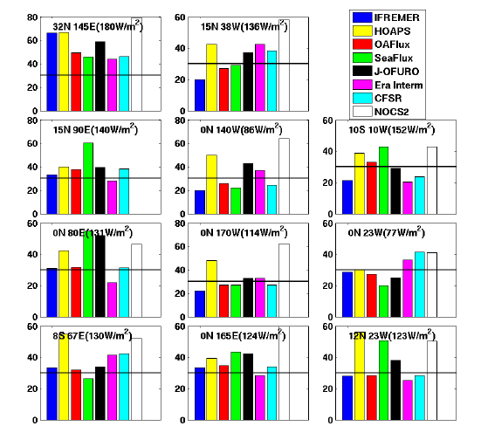
Estimates of satellite errors and sources
perhaps
30 W m/2
LHF RMS differences at OceanSites locations

Slide 7
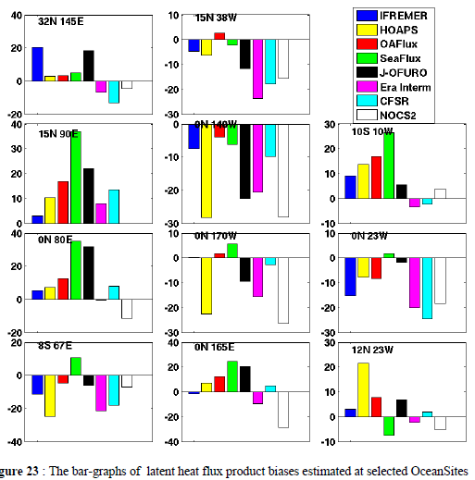
Estimates of satellite errors and sources
perhaps
10 W m/2
LHF bias at OceanSites locations

Slide 8
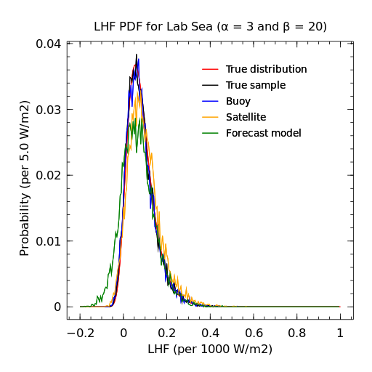
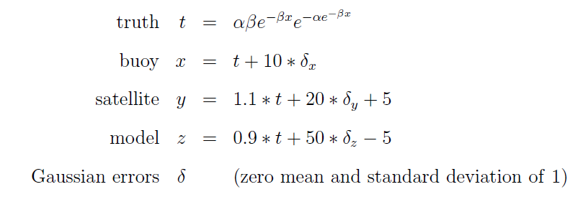
Experiments with retrieving errors in hypothetical independent flux data by triple collocation

Slide 9
Experiments with retrieving errors in hypothetical independent flux data by triple collocation
Specified (calibration, std,bias) | Retrieved following McColl et al. (2014), Extended triple collocation to correlation coefficients with respect to an unknown target
x : (1.0, 10, +0) | x : (1.0, 9.9, +0)
y : (1.1, 20, +5) | y : (1.09, 19.9, +5)
z : (0.9, 50, -5) | z : (0.89, 49.9, -5)
 | x Signal:Noise 0.988
 | y Signal:Noise 0.962
 | z Signal:Noise 0.756

Slide 10
Feasibility of performing triple collocation
Independence of data…specifically of analyses

Slide 11
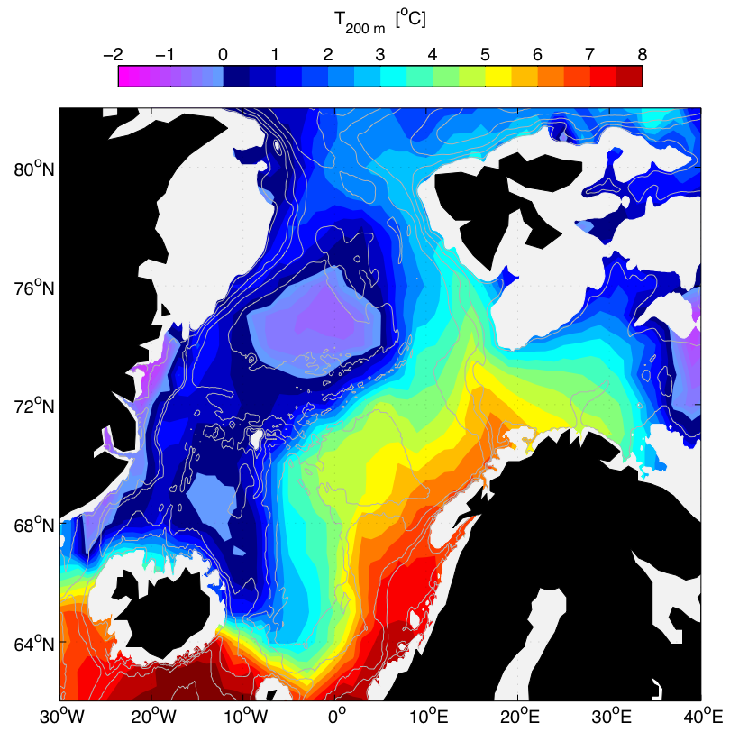
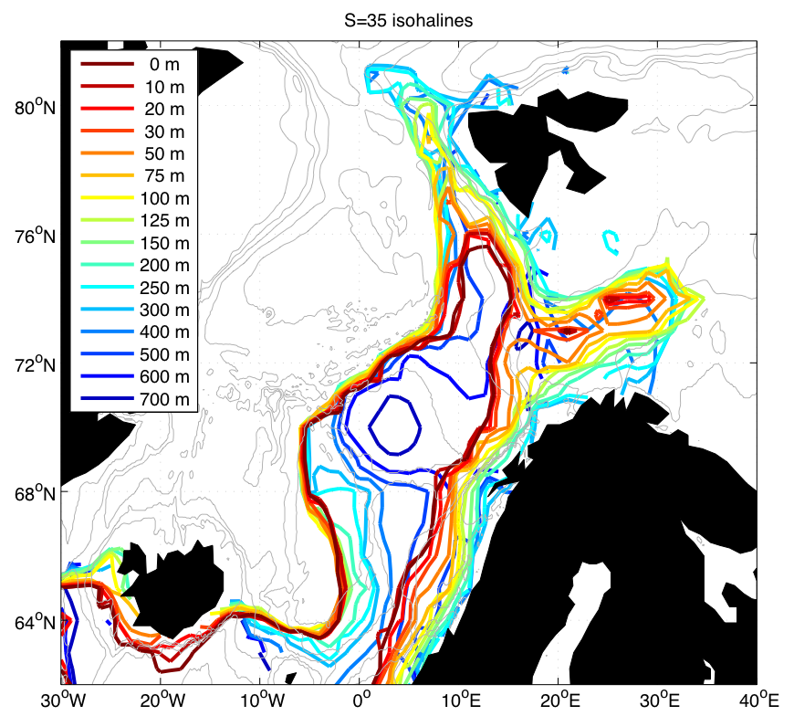
Atlantic Water and general circulation
Full year climatology from 1948-2006 hydrography
Notes:
The data are mainly ICES with additions from Iceland, Faroes, Norway and Russia in a collaboration called Norwegian Iceland Seas Experiment.
Strong topographic steering: Both barotropic and baroclinic flows
Cyclonic circulation
# Fram Strait
(next I’ll show cros sections through this climatology)

Slide 12
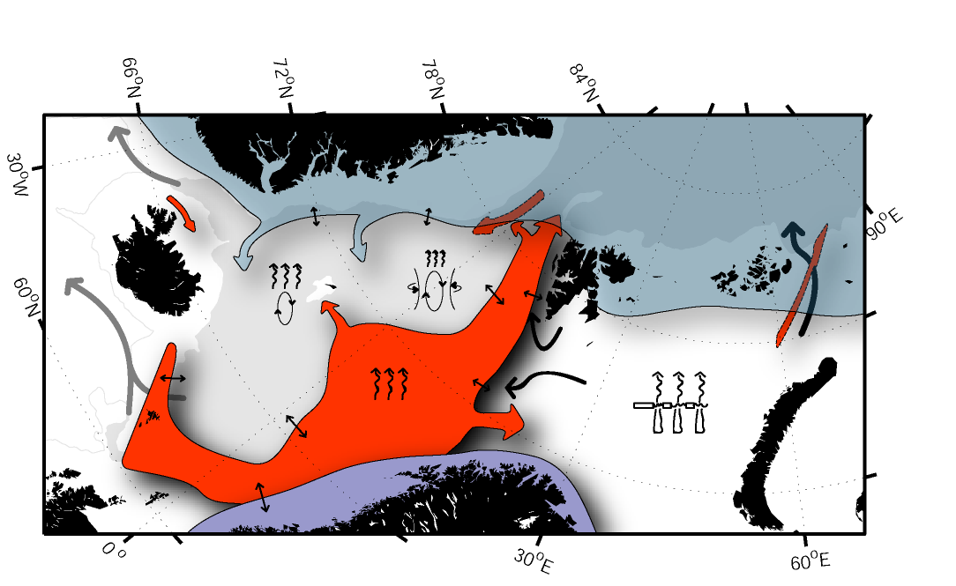
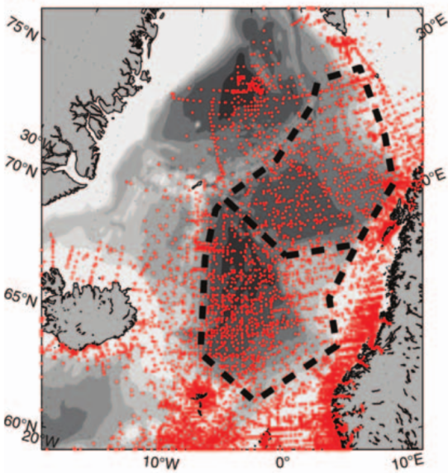
Transformation and ventilation hypotheses
The Atlantic inflow loses 80-90% of its heat before it reaches the Arctic Ocean
Heat exchanged across the Arctic Front may be similar to flux into the Barents Sea
GSG-convection may contribute less to OW-production than Cold shelf water and the
Norwegian Sea densified AW (variability dominated by transports; cf. Skagseth&Mork 2012)
Iceland Sea
Greenland Sea Gyre
1995-
2010
obs
Shelf and Ice Processes
Mixing between Atlantic and Arctic Water
Freshwater from Coastal Currents
Atmospheric Cooling
Notes:
Eastern view.
Now also including the Coastal Currents.
Eddy mixing along the Arctic Front
Freshwater makes lighter, but still has to be mixed into the AW and central areas. However will not talk about FW here (reer to ASOF reports).
AW is cooled from above, as well as by lateral mixing.
Cooling and brine release
Deep open ocean convection.
Review current knowledge about water modification and dense water formation (ventilation) in the Nordic Seas
Use some simple approaches to quantify further using observations and models
Synthesize with emphasis on the processes’ relative contributions to OW
Brief preview of that in this talk.
Pinpoint key geographical areas
Give short overview of forcing
Quantify fluxes/contribution from process

Slide 13
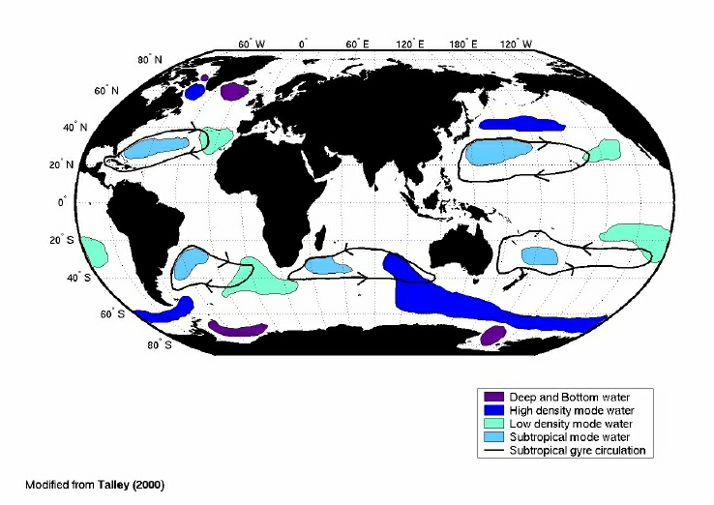
Distinguish Mode Water Regions
All have strong property correlations with atmospheric indices(?)
Mode waters are upper ocean waters
Uniform temperature over thickness of few 100-m
Short renewal timescales
26.2
26.5
25.2
24-25.4
25.5
25.5
26.0
26.2-26.7
26.0
26.2-26.3
26.85
Eighteen Degree Water

Slide 14
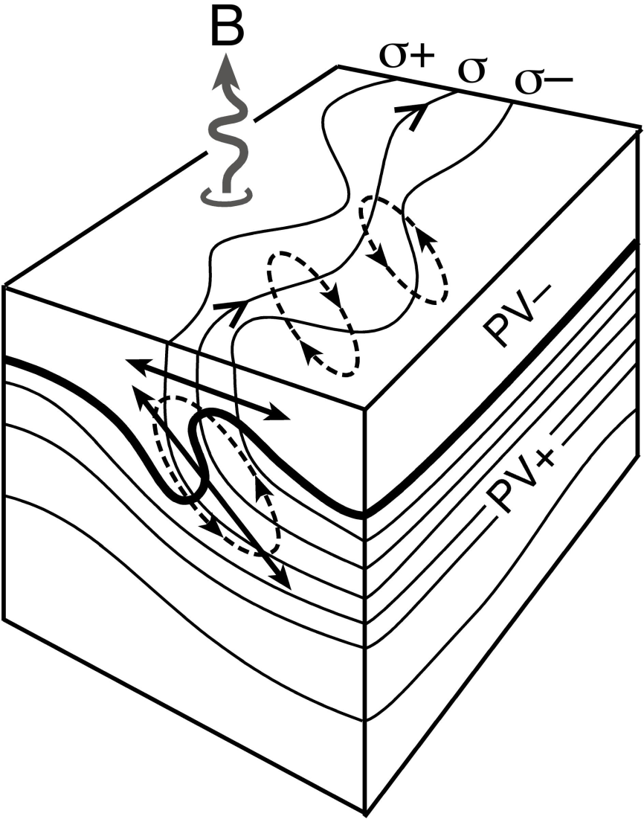
Rates & Mechanisms
Best available estimates of formation and dissipation rates:
≈15-20 Sv yr⁻¹ (indirect methods from air-sea fluxes)
only about 5 Sv yr⁻¹ inferred to be injected seasonally into the subtropical gyre
18° Water enters North Atlantic thermocline:
Ekman pumping, and
Eddy driven subduction
Notes:
Schematic showing the interaction of a mixed layer (low PV) and the stratified interior (high PV) in a strong frontal region with outcropping isopycnals, σ, undergoing buoyancy loss, B. Eddies forming along the front play a central role in controlling horizontal fluxes through the mixed layer and a 2-way exchange between the mixed layer and the interior.

Slide 15
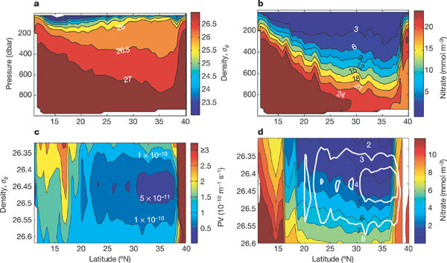
18° Water and the Nutrient Gradient
Notes:
The effect of the STMW on the subsurface nutrient gradient is more thoroughly demonstrated by examining a WOCE meridional section across the subtropical North Atlantic (Fig. 3). The STMW is apparent as a wedge of nearly uniform density water between the depths of 150 and 400 m, to the north of 20° N (Fig. 3a). As evidenced from an inspection of the nitrate cross-section, the presence of the STMW coincides with the deepening of the nutricline (Fig. 3b). Because mode water is convectively formed, it is characterized by a low vertical density gradient and, thus, a local minimum in the absolute value of potential vorticity (PV) (Fig. 3c)¹⁰. PV is a convenient tracer of the water mass, as it reflects the local density gradient and tends to be preserved away from the formation region as it has no internal sources or sinks. In the WOCE nutrient sections, a noticeable front in nitrate at the edge of the PV minimum (at roughly 20° N) provides evidence that STMW has a much lower nutrient concentration than surrounding water at the same density (Fig. 3d). Along a single density surface, nitrate concentrations within the STMW are roughly half that outside the zone of STMW recirculation¹¹. These richer waters are further from their ventilation sources, and thus older.

Slide 16
18° Water & Potential Vorticity
The presence of 18° Water is reflected in a substantial 1000 km diameter ‘bowl’ of low potential vorticity at depths of 200-500m found just to the south of the Gulf Stream
Red = high PV, Purple = low PV

Slide 17
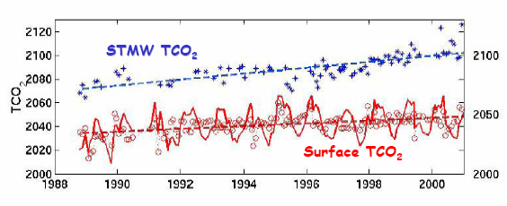
Importance of 18° Water
Dominant baroclinic and potential vorticity signal in the subtropical North Atlantic
Substantial contribution to interannual variability in oceanic CO₂ uptake (0.03−0.24 Pg C yr⁻¹ from 1998-2001)
Can prohibit deep-ocean nutrients from directly upwelling to the "euphotic" zone (wedge of cool, nutrient-poor water)

Slide 18
References
http://www.nature.com/nature/journal/v420/n6915/abs/nature01253.html
http://sam.ucsd.edu/sio210/lect_5/lecture_5.html
http://www.nature.com/nature/journal/v437/n7059/full/nature03969.html
http://www.whoi.edu/science/PO/people/tjoyce/clivar/clivarindx.htm
http://www.climode.org/documents/climode_science_final_overview_REFs.pdf
http://ams.allenpress.com.ezp1.harvard.edu/amsonline/?request=get-document&issn=0894-8755&volume=013&issue=14&page=2550
http://www.uib.no/jgofs/Final_OSC/Bates.pdf
http://sam.ucsd.edu/sio210/gifimages/shallowoverturn.gif
http://www.climode.org/Meetings/NOV_04/kwon_nov04.pdf

Slide 19
18° Water Dissipation
starts w/ subduction & advection into the western subtropical gyre
also due to lateral flows, diapycnal mixing and fluxes
~48% observed winter volume destroyed annually.
S_{ann} = 1.23 x 10¹⁴ m³
μ_{ann} destruction = 1.06 ± 0.16 x 10¹⁴ m³
Turnover = 3.54 ± 0.54 yr

Slide 20
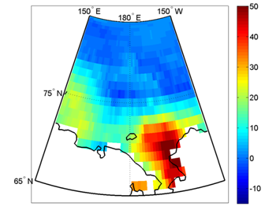
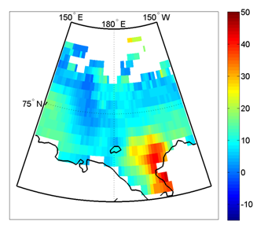
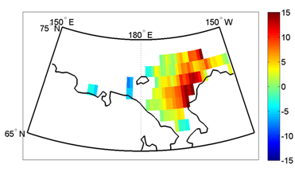
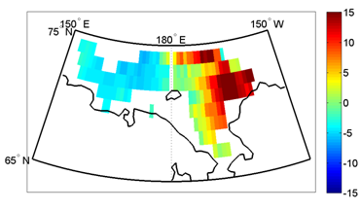
Air-sea flux evaluation with turbulence resolving model PALM
Background: The air-sea flux is evaluated with semi-empirical bulk flux-gradient algorithms (e.g. COARE by Fairall et al. JGR, 2003) or single-column models, which incorporate such algorithms (e.g. GOTM by Burchard et al. JPO, 2001; MLOM by Stephens et al. JClim, 2005)
C is an empirical function (~10⁻³ in neutral, moderate wind PBL) with non-linear dependence on a number of parameters
Problems: (1) Very sensitive to the choice of empirical functions and parameters (differences in satellite flux products); (2) Does not account for non-local nature of turbulence (large biases in non-neutrally stratified layers); (3) Produce inconsistent fluxes within atmosphere and the ocean
Solution: For climatological estimations a set of correction to the bulk fluxes could be introduced based on evaluation and intercomparison of the actual flux taken from PALM runs and the flux obtained with bulk algorithms.
Sensible (right) and latent (left) climatological September heat fluxes in two gridded satellite products (AOFLUX – upper raw; HOAPS3 – lower raw) using COARE algorithm with different coefficients.

