Slide 1
Towards Improved Estimates of Ocean Heat Flux (TIE-OHF)
Draft for Requirements baseline document
ESA/TIE-OHF meeting, January 2015
Ifremer Headquarter, Paris

Slide 2
Towards Improved Estimates of Ocean Heat Flux (TIE-OHF)
Draft for Requirements baseline document
ESA/TIE-OHF meeting, January 2015
Ifremer Headquarter, Paris
Suggestion:
I will generate a first draft, send it around to complement (project partners only); note: regarding to discussion with ESA yesterday, we have only a short time window for this step, please collaborate!)
And then I will send this draft to all partners/collaborators of the project for dicussion and overall agreement on the defined requirments (first agreements already expected during meeting today)

Slide 3
Towards Improved Estimates of Ocean Heat Flux (TIE-OHF)
Intro:
General description of TIE-OHF and broader context (e.g. link to CLIVAR Research Focus)
Main objectives for this document and how these will be achieved (e.g. paper assessments, information from other projects, e.g. ORA-IP and white papers (e.g. Ocean Obs 2009; WHOI/GSOP wrokshop 2012 ➔ other suggestions (➔ maybe comments from M. Bourrassa?)
➔ Milestone of the project, as this document serves as the principal basis to build up the “reference dataset”

Slide 4
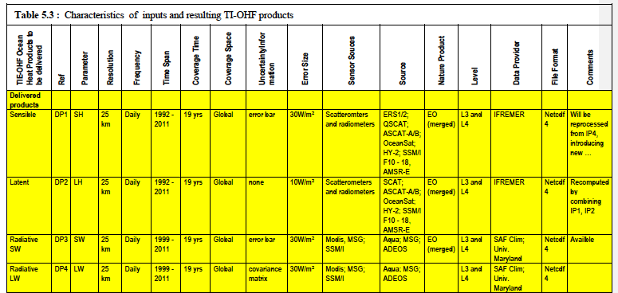
Towards Improved Estimates of Ocean Heat Flux (TIE-OHF)
2. Description of raw input data (re-processed satellite parameters)
Table of proposal: and some description (please add bullet points)

Slide 5
Towards Improved Estimates of Ocean Heat Flux (TIE-OHF)
3. Description of raw products for TIEH-OHF
3.1 Intro (e.g. choice of data for this project is focussed on observations as it is dedicated for; use of only 1 reanalysis for comparison; BUT: Similar inter-comparison objective establishs strong link to ORA-IP)
Overview on products generate similar figure as:
Short description of product types (e.g. blended, remote sensing, reanalysis, In Situ)

Slide 6
Towards Improved Estimates of Ocean Heat Flux (TIE-OHF)
3. Description of raw products for TIEH-OHF
3.2 Meta-Data
Use information from interface-control document (Jean-Françoise, Antoine)
3.3 Strength & weakness: key performance of products
Recommended uncertainty range ➔ CLIVAR recommendation ? (discussion/agreement)
Confidence mask: build a “reference climatology” from the reference data set (ensemble climatology? Or one product only? Or for each product? ➔ to be discussed and agreed), which will be distributed with the reference dataset (very valuable for community!); then: build confidence mask: departure from climatology
Check whether other methods for performance tests can be useful by assissing review paper Ocean Obs,/ WHOI worksho, ORA-IP (paper of Magdalena, research gate draft (currently most recent one).

Slide 7
Towards Improved Estimates of Ocean Heat Flux (TIE-OHF)
3. Description of raw products for TIEH-OHF
3.4 Ensemble method
➔ discussion/input needed; maybe information available from ORA-IP (paper Magdalena?)
3.5 Resampling in time and space (“homogenization”)
Resolution in space and time? Discussion/agreement
File format and file name (please find agreement)
Variable names: to be fixed through Essential Climate Variable (GCOS)

Slide 8
Towards Improved Estimates of Ocean Heat Flux (TIE-OHF)
Further points to be discussed:
Are there additional information needed in the document?
Who will be dedicated to lead and organize the BAMS proposal? Abderahim? Deadline?? ➔ IMPORTANT to start very early, as scientific discussions are expected…: Maybe discuss here: what are you aiming to address there? Define main objectives/thematics (bullet points)
Further communication: workshop/conference/meeting
Joint TIE-OHF/SOLAS workshop: convenor team? Please agree
GCOS/CLIVAR/?: September 2015 (ESA), please add link here
Joint CLIVAR RF/GSOP/COST (reanalyses) meeting, to be planned for fall 2015 in Exeter, MetOffice (location confirmed)

